Slide 1


Slide 2
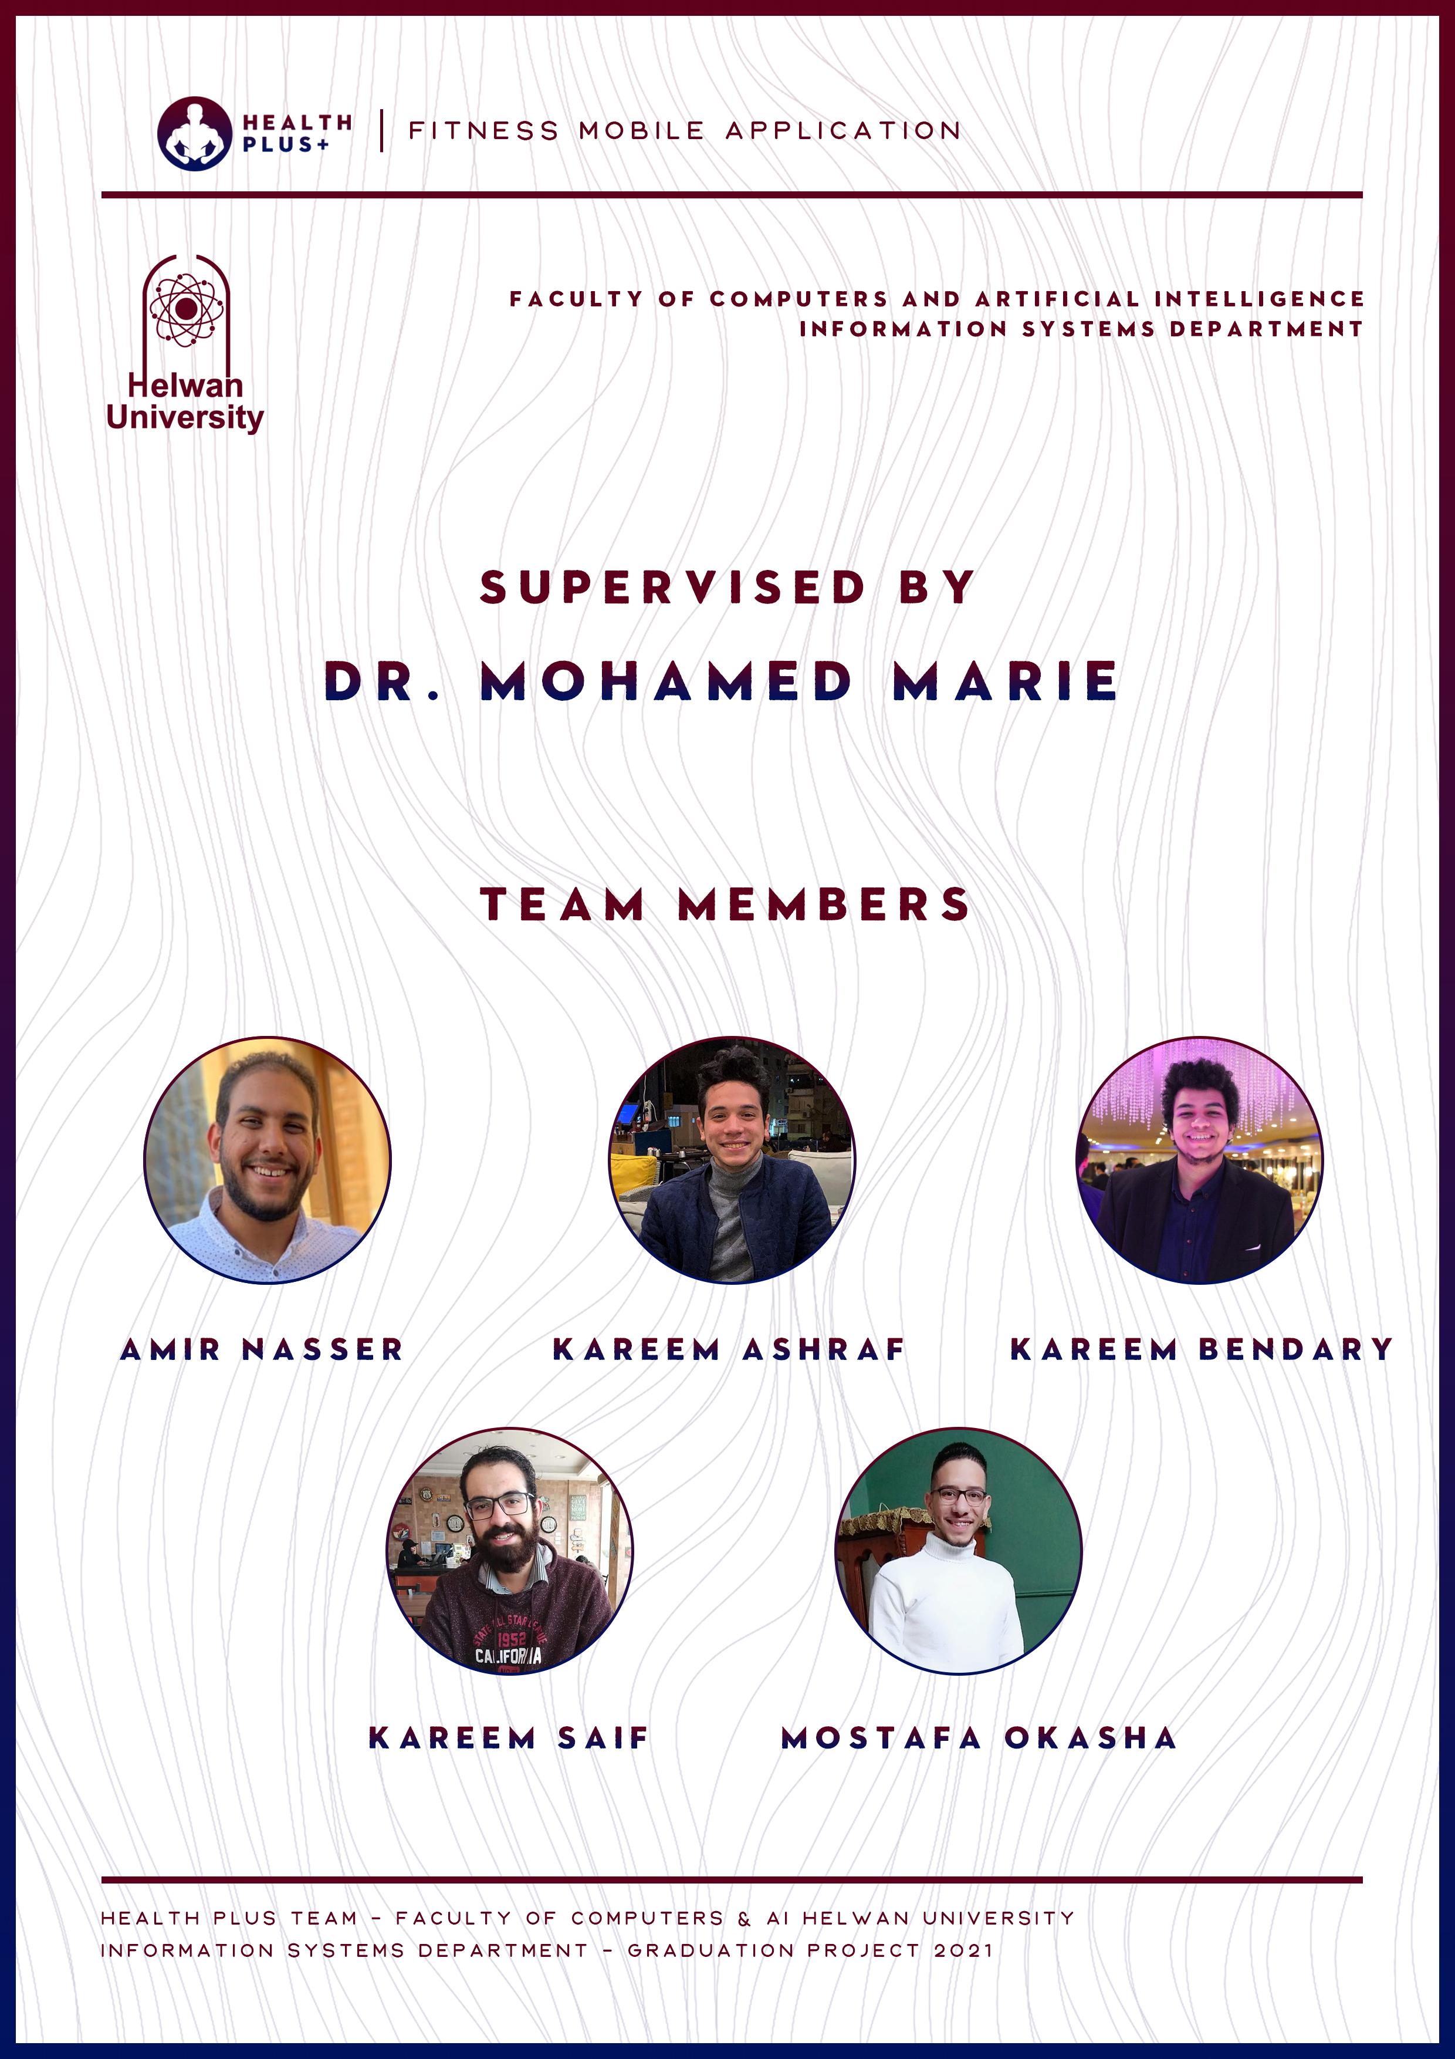

Slide 3
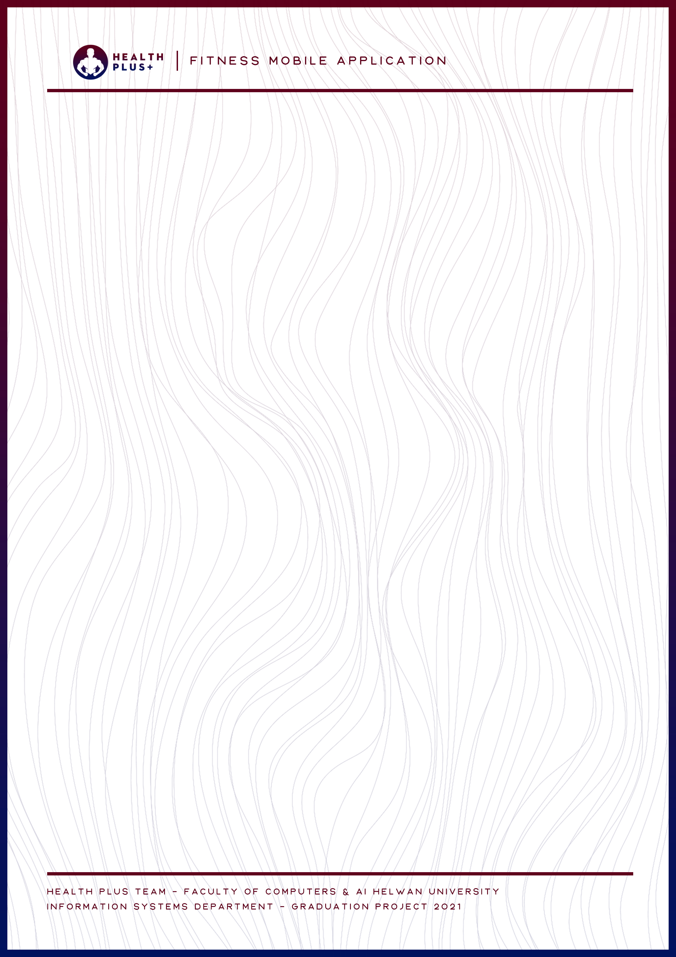
Acknowledgement
First and foremost, we would express our deepest gratitude and appreciation to our advisor Dr. Mohamed Marie for his support, outstanding guidance and encouragement throughout our graduation project and her continuous support and help as he was always there for us providing more than the needed from him since the very beginning of our project.
We would also like to thank our families, especially our parents, for their encouragement, patience, and assistance over the years. We are forever indebted to our parents, who have always kept us in their prayers and pushed us to Success. Finally, for our faculty for providing the suitable environment that leaded us to represent the best image that computer science graduates of Helwan University are supposed to represent

Slide 4
Table of Contents
Chapter 1: Introduction _________________________________________ 11
1.1 Project Overview _____________________________________________ 12
1.2 Purpose ______________________________________________________ 12
1.3 Objectives ___________________________________________________ 13
1.4 Scope
of
Project ____________________________________________ 14
1.5 Scope
of
Work ______________________________________________ 14
Chapter
2:
Planning and Study ________________________________ 18
2.1 Project Planning ______________________________________________ 19
2.1.1 Feasibility Study ___________________________________________19
2.1.2 Estimated Cost __________________________
________________ 25
2.1.3 Gantt Chart _____________________________________________ 26
2.2 Analysis
of
Existing System __________________________________ 28
2.3 Analysis
for
New System _____________________________________ 29

Slide 5
2.3.1 User Requirements ______________________________________ 29
2.3.2 System Requirements ___________________________________ 30
2.3.3 Domain Requirements ______________________________
_____ 31
2.3.4 Functional Requirements ________________________________ 32
2.3.5
Non
Functional
Requirements __________________________ 35
-
2.4 Advantages for the new System __________________________ 38
2.5 Risk Management ________________________________________ 39
Chapter 3: Software Design _____________________________ 43
3.1 Class Diagram ________________________________ 44
3.2 Sequence Diagram ____________________________ 45
3.2.1 Add Gym Plan ____________________________ 45
3.2.2 Add Post ________________________________ 46
3.2.3 Detect Calories __________________________ 47
3.2.4 Request Being Coach ______________________ 48
3.2.5 Follow\Unfollow __________________________ 49
3.2.6 InBody Info ______________________________ 50
3.2.7 Login ___________________________________ 51
3.2.8 Messenger ______________________________ 52

Slide 6
3.2.9 Search __________________________________ 53
3.2.10 Sign Up ________________________________ 54
3.2.11 Subscribe Gym Plan ______________________ 55
3.2.12 View Time Line __________________________ 56
3.3 Activity Diagram _____________________________________________ 57
3.3.1 Coach __________________________________ 57
3.3.2 User ___________________________________ 58
3.4 Use Case Diagram ____________________________________________ 59
3.4.1 Admin _________________________________ 59
3.4.2 Coach __________________________________ 60
3.4.3 User ___________________________________ 61
Chapter 4: Implementation _____________________________ 62
4.1 Algorithms ___________________________________________________ 63
4.1.1 Search _________________________________ 63
4.2 Software Architecture _______________________________ 63
4.3 Screens __________________________________________ 84
4.4 Flowchart ________________________________________ 91
4.4.1 Coach _______________________________________ 91
4.4.2 User ________________________________________ 92

Slide 7
4.5 Software Tools _____________________________________93
4.5.1 Flutter _________________________________________93
4.5.2 Firebase _______________________________________ 93
4.5.4 Android Studio and SBK tools ______________________ 93
Chapter 5: Testing ________________________________94
5.1 Functional Testing _________________________________95
5.1.1 Unit Testing ___________________________________ 95
5.1.2 Integration Testing ______________________________ 95
5.1.3 System Testing _________________________________ 95
5.1.4 Regression Testing ______________________________ 95
5.1.5 Acceptance Testing ___________________ __________ 95
5.2 Non Functional Testing ____________________________ _ 96
5.2.1 Performance Testing ____________________ ____ ____ 96
5.2.2 Load Testing ________________________________ ___ 96
5.2.3 Stress Testing _______________________________ ___ 96
5.2.4 Security Testing _________________________________ 96
5.3 Test Cases _________________________________________97

Slide 8
Chapter 6: Results and Discussion __________________100
6.1 Expected Result _________________________________ 101
6.2 Actual Result ___________________________________ 102
Chapter 7: Future Work _________________________ 104
Chapter 8: Conclusion ___________________________106

Slide 9
Abstract
Main idea:
Healthy Plus is providing core functionality of complete social media network and healthy lifestyle to the community , with capability of using machine learning to detect the food in the pictures and provide the detect number of calories .
Also provides a fully functional exercises categories to give the user the ability to navigate whatever he wanted from the exercises to get fit and get healthy body , and the admin is the responsible for adding these exercises .
And the application is also giving you the functionality of getting the most suitable advices pending on your height and weight with standard classification .
Also you can request being a coach with different capabilities and features to add your gym plans and let the users to subscribe and you get the ability to accept or refuse those who you don’t suppose to get them at your package.
So you already can get these gym plans and follow and unfollow users and chat with them .

Slide 10
Structure:
A Fitness & Healthcare application with advanced technologies/ processes
Technical Architecture\ Description:
Application service - Android & IOS
Flutter Framework
Firebase Cloud Database
Firebase Auth
Firebase Storage
Google Sign In
Pedometer
TensorFlow lite
• Our application is built with Flutter, portable runtime for high-quality mobile applications. It implements Flutter's core libraries, including animation and graphics, file and network I/O, accessibility support, plugin architecture, and a Dart runtime and toolchain for developing, compiling, and running Flutter applications.
• Supporting it with Firebase; having a database that provides a cloud database and backend and Firebase Auth that can authenticate users and Google Sign In.
• We are using Android studio for developing.

Slide 12
Overview :
Healthy Plus is an application for fitness players who wants to communicate with and get online gym plans and following capabilities to all users to see them posts and online healthy life style. And also using the camera/gallery to get the calories in the detected picture.
Purpose :
The application aims to help fitness players that got rejected from going to gyms while Corona Virus, so We provided the online solution to the community .

Slide 13
Objectives:
•
Our application regularly analysis the user inputs’
like weight
,
height
and
Calculate your caloric needs
and Calculate all your
macronutrients
.
•
By using
Health Plus+
you can track
the various physical
,
step using the various built-in trackers.
•
Our application allows you to
Calculate
the number of
calories of any food
only
by photographing it with your mobile
camera
.
•
Choose your goal, lose weight, maintain it or gain muscle
mass.
•
Nutritional information of thousands of foods.
•
Distribute the number of calories of your meals.
•
P
rovides you with a daily exercise regimen for
all
your major
muscle groups
like chest, legs, arms,
and back
as well as
exercises for the whole body
. In just a few minutes a day, you
can
build muscle and stay in shape at home without having to
go to the gym. No equipment or coaches
required;
you can
perform all exercises with just your own body weight.
With
video instructions for each exercise, you can ensure you are
using the correct
form during each exercise.

Slide 15
Determining the diagrams to be needed like:
Activity Diagram
Class Diagram
Use-case Diagram
Sequence Diagram
Flowchart Diagram
Coding:
Coding those functions:
1- pick_the_imageOfFood (){} ;
2- check_callories_in_image(){};
3- enter_food_content(){};
4- check_callories_of_this_content(){};
5- food_callories_checker(){};
6- check_callories(BarcodeReaderProduct){};
7- runnungtracker(){};
8- followuser/unfollow(){};

Slide 16
9- walkingstepstracker(){};
10- enterUserinformation(height, age , weight ){};
11- giveInstructiondependsOnthisInfo(enterUserinformation){};
12- FunctionToCalculateSuitableCallories(){};
13- NavigateTypeOfExcersices(){};
14- NavigateCategorisOfType(Type type){};
15- ChooseNeededType(){};
16- showExcersices(){};
17- showCoaches(){};
18- showbillingplans(){};
20- Subcribe plan(){}
21- chatWithCoach(){};
22- updateProfile(){};
23- showCoachInfoProfile(){};
24- showCoachPosts(){};
25- logout(){};
26: fetchposts(){};
27: fetchPersonPosts(){};
Testing:
Functional testing:
Unit testing.
Regression testing.
Integration testing.
System testing.
Acceptance testing.
Non-Functional testing:
Performance testing.
Stress testing.
Load testing.
Security testing.

Slide 19
2.1 Project Planning
2.1.1 Feasibility Study
In order to determine the achievability of this project we need to view more in these aspects:
The problems that the project solves:
This project will help fitness people to act better in them lives without pressurizing them selves in contracting deals with coaches or trainers and take the m time and them effort in nothing , so this application will help these people act better while choosing the most suitable exercises to them bodies and get the best result that will relate good with them life gym style , and also will help regular people to identify how many calories per meal by= giving the app the data of the meal or even picture it simply and the application will calculate and identify how many calories in this pictures using our databases and dataset processing and image processing
Whom will the project benefit?
- Athletes
-fitness players
- health care seekers
Reasons why we chosen this project to work on:
• The huge impact of regular peoples life when they identify how many calories in any meal has.
• Helping athlete people to lead a better life.
• Making it easy for trainers to follow-up and prescribe well with coaches.
• Contribute in society development using technology.

Slide 20
Project Importance :
Will help all type of health care seeker to identify how many calories in them meals ,
Will help trainers get beautiful and suitable exercises to them body building,
Wil give the scope the benefits and good result depends on them information like weight and height.
Will give the coaches easy payment way and source to earn
Will give the trainers best coaches in the fields of what they need
Market analysis:
• Main competitors:
o Map My Run
o Fitness Buddy
Unique points in our project:
People can picture the food to get how many calories in it.
Trainers can deal with coaches online
Trainers can get best result depends on them body info
Trainers can acsses the way of how to train and get free exercises techniques
Getting the food calories from only one pictures.

Slide 21
• Target Market:
o Age: 20 – 80.
o Gender: Both.
o Place: we’ll start from Egypt then will expand world widely.
o Income Level: 50$ and above.
o Education level: Elementary school education and above.
o Relevant behavioral factor: can use a smart phone and have basic
knowledge about diabetes.
Organizational and operational analysis:
• Number of team members this project will need:
o 5 developers incluinng 1 UI designer and 1 tester .
• To keep the work on this project we shall provide:
o Rules Manual.
o Regular Trainings.
o Safe Environment.
o Modern Management.
o Good work place.
o Efficient work tools.

Slide 22
• Sales Strategy:
To increase sales we have to take care of important points like:
o Check for and follow up customers’ complaints regularly.
o Execute regular testing.
o The application is completely free but it will contain customized
medical ads on the application to be benefited from.
o Keep the patients engaged with promotions and offers.
• Distribution Strategy:
o An advertising agency to work on visual identity, SNS marketing.
o SEO developer to increase the traffic to website and app.
o Deals with specialized doctor, clinics and hospitals to put them on
our app, on the other hand they recommend their patients to use
our app..

Slide 23
Technical analysis:
• No Hardware required for the app.
• Main technologies and programs we’re associated with:
o Application service - Android & IOS
o Flutter Framework
o Firebase Cloud Database
o Firebase Auth & Firebase Host
o Android Studio – Microsoft Visual studio
o Microsoft Project
o Adobe XD – Adobe Photoshop
o Lucide Chart

Slide 24
Resource and Time analysis:
• Resources needed:
o Devices for coding, running and testing – Laptops and mobile
phones.
o Coding programs.
o Internet service.
o Design programs.
o Calories data sets.
o Maps API - packages.
o Flutter & Firebase libraries and packages like material design, icons,
widgets, etc.…
• Time schedule:
o 1 month for planning.
o 2 months for development.
o 1 months of testing

Slide 25
2.1.2 Estimated cost
The budget of the application as programming and its process includes:
• Renting equipment for interview = 200 LE
• Purchasing a Flutter & Dart course = 200$
• Publishing the application on App Store = 99$\year
• Publishing the application on Google play =25$
• Meeting in a public workspace.
• Book appointments with specialized doctors

Slide 26
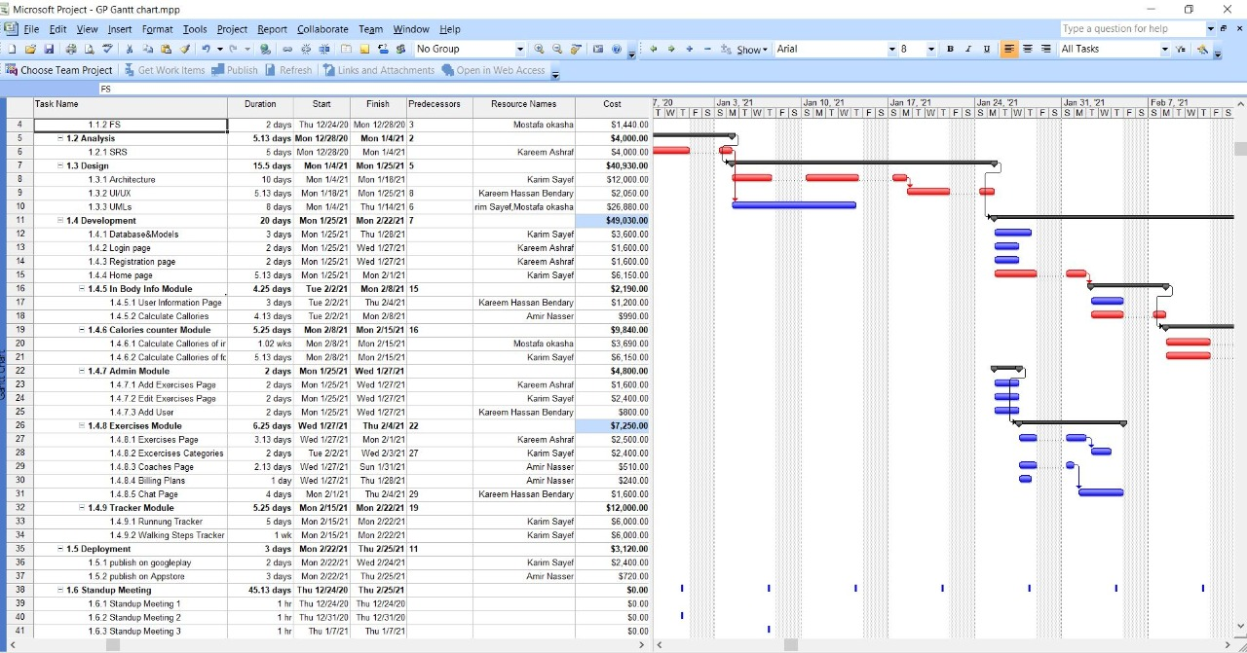
2.1.3 Gantt Chart :

Slide 27
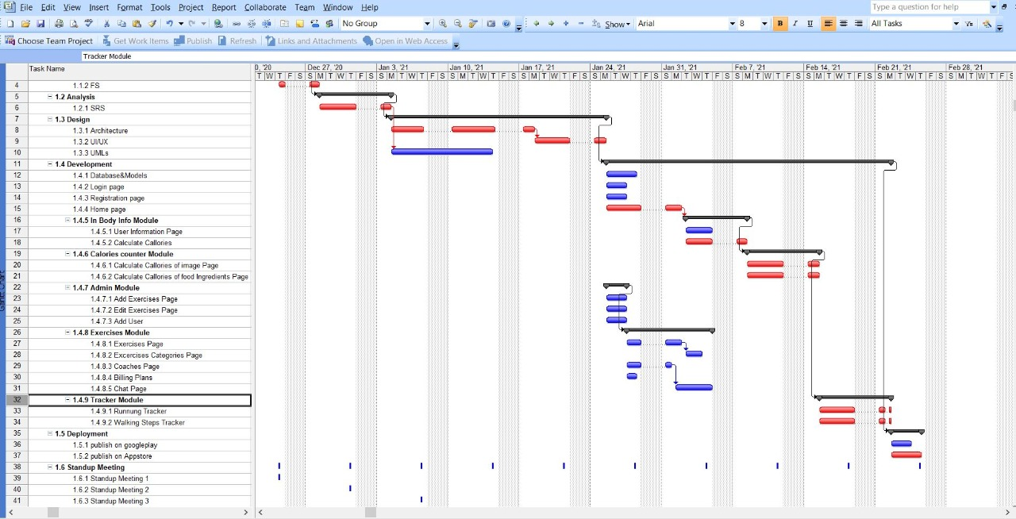
2.1.3 Gantt Chart

Slide 28
2.2 Analysis of Existing Systems
 | Fit On | Health Mate | Samsung Health
Calories Calculator | ✗ | ✗ | ✗
Steps Tracker | ✗ | ✓ | ✓
Exercises | ✓ | ✓ | ✓
Gym Plans | ✓ | ✓ | ✓
Connect With Community | ✗ | ✗ | ✓
Connecting with coaches | ✗ | ✗ | ✗

Slide 29
2.3 Analysis for new system:
2.3.1 User Requirements
Mandatory requirements:
- the user will enter his in-body information to detect what is the suitable calories to burn for him and the suitable weight .
- the user will get the information’s about what kind of meals ands food he supposed to get to reach out the suitable body situation
- the user will choose the exercise that needs so we afford best coaches in this fields.
the user will have many amazing programs to roll in from needed exercises.
Optional requirements:
- the user will choose exercises and we give him the best instruction for him
- the user will detect the rates of those coaches
Desirable requirements:
- the user will get the real time calculation of calories from the live camera of food content
- the user will get the calculations of calories using user-input method of food content.

Slide 30
2.3.2 System Requirements
• Android & IOS
Since our app’s code would be written with Flutter\ Dart it’ll work on
both android & IOS’s all versions. Because it’s as knows “ Cross platform “ so its supports both platforms
• Camera
This application needs the camera because it will scan the content of food using the firebase machine learning vision
• GPS
The application will need to know the users place in order to locate
And detect the distance and the calculated calories if they walked or run these distances
• Internet connection
Since we would need to keep the users data in the cloud, we need
an internet connection to store and retrieve the data.
• Storage space
In order to keep the user’s data in addition to the application itself,
so we need a fine storage.

Slide 31
2.3.3 Domain Requirements
o Enough memory should be reserved for on the database server to
accommodate for any number of users and their data.
o Reports are required.
o The necessary software required to run the application.
o Each user must have a unique user-name/password combination.
o The database should be backed up every occasionally in case the
original does become corrupt.
o The application must have update capabilities for future models
and accessories

Slide 32
2.3.4 Functional Requirements :
1-Use case | register
Actors | User
Precondition | open register window
Basic flow | 1-fill the data of the registration forum which is: user name ,password , mail , phone 2-click submit 3-check data validation 4-save data in database
Alternative flow | Data is wrong and data not saved
Post condition | 1- An activation message will be sent to user’s e-mail 2-open profile page
2-Use case | Login
Actors | User Coach admin
Precondition | Register open login window
Basic flow | 1-enter user name and password 2-click login 3- search for data in database 4- Fetch user key
Alternative flow | User data not found in database
Post condition | A home page will be opened according to each actor
3-Use case | Logout
Actors | User Coach admin
Precondition | Login
Basic flow | 1-open profile page 2-click logout
Alternative flow
Post condition | The logout will redirect to login page

Slide 33
4-Use case | Search for user
Actors | User Admin Coach
Precondition | Open a search page
Basic flow | 2-write name 3-click search beside the text box
Alternative flow | the name is wrong
Post condition | All users will be appear
5-Use case | Edit profile
Actors | User Coach admin
Precondition | Login
Basic flow | 1-open my profile 2- press edit button 3- Update data 4- click on update
Alternative flow
Post condition | The data will be updated in the database
6-Use case | View category and exercises
Actors | User Coach admin
Precondition | logged in
Basic flow | 1-open profile 2- Select a specific category 3- Show all exercises
Alternative flow
Post condition | The category and exercises will be displayed
7-Use case | Follow people
Actors | Admin User Coach
Precondition | logged in
Basic flow | 1-open a user`s peofile 2- follow user
Alternative flow
Post condition | I can see all activites and posts of this user

Slide 34
8-Use case | Add post
Actors | User Coach admin
Precondition | logged in
Basic flow | 1-open control page 2- select post 3-click add post button 3- enter place details
Alternative flow
Post condition | The post will be added in the database and will searched by guest
9-Use case | Show control page
Actors | admin
Precondition | logged in
Basic flow | 1-open control page
Alternative flow
Post condition | Show places status and names Update app welcoming data Add category Verify people
10-Use case | View profile
Actors | User Coach admin
Precondition | logged in
Basic flow | 1-open profile
Alternative flow | The user name and pass is wrong so user can't login
Post condition | The profile will be displayed
11-Use case | Enroll to gym plan
Actors | User
Precondition | logged in
Basi1c flow | 1- open gym plans page 2- Select a specific gym plans 3- Fill the form
Alternative flow
Post condition | The reservation notification will be sent to coach

Slide 35
2.3.5 Non-Functional Requirements
• Availability:
o The user will be able to use the application at any time, can record his data even if no internet, that data will be recorded to the mobile’s cache and it’ll be sent again to the database when the internet is available.
o User’ data cannot be showed \updated without an internet connection.
o The locating cannot work without an internet connection and GPS.
o Small storage for the users’ data is required, if no storage is available, the user shall be notified that data they will add will be lost or cannot be shown.
o Under bad circumstances, the application shall present a user with notification informing them that the system is unavailable.
• Maintainability:
o If the application is under maintenance, we’ll firstly inform the users via notification if it will affect any vital function, then the existed data of the user
shall remain saved aside but the newly added data won’t be added till the maintained is over.
o Any new feature must not impact any of the dashboard functions.
o The customer service manager shall analyze 95% of the problem reports within 2 hours and repaired within 2 days.
o The system shall not be shut down for maintenance more than once in a 48‐hour period.

Slide 36
• Security:
o Any unauthorized access to the application is denied, no one can use the application without creating an authorized account.
o All the userss are verified.
o Authentication and authorization made for every role of registered users.
o User’ data cannot be shown to other users, or any non-given access coach.
o Passwords shall never be viewable at the point of entry or at any other time.
o The access permissions for any data may only be changed by the application developers.
o The access that the coach has on the user’s data may be only changed by the coach or the patient.
• Usability:
o The user will have mini training tips on the first time he uses the app.
o The user can add his data within 3 clicks, which will take no time to submit.
o The accessibility of interface is very important since old people are likely to use the app, so that we followed Google material design, colors and fonts.
o The application shall be easy to use by adult members (age 18 to 80).
o All the main tasks are shown in the dashboard with a different colors, all the buttons are oblivious.

Slide 37
• Flexibility:
o No piece of text that might be displayed to a user shall reside in program source code. Every piece of text that a user might see must be modifiable without changing source code.
o Users can edit or modify their data any time.
o Users’ records shall be suitable for use by any specialized Coach in any country.
• Scalability:
o The application will be updated so it can serve more users (that increases gradually), process more data and do more transactions.
o Any added feature or function mustn’t affect the storage massively.
o Time to calculate any data mustn’t increase with users’ number increasing.
o Functions and roles shall be scaled for the number-growth of the users.
o The support manager shall support unlimited users inquiries.
• Efficiency:
o The application needs at most 1% percent of the battery usage and at most 80 MB used storage space should available in the phone, which shall be all-unused at high load.
o The application shall be able to handle the entry of users’ records at a minimum rate of 5 per second.
o Any live interaction between a user and the customer services manager shall have a maximum response time of 2 minutes.
o Routine maintenance that is executed while users are active shall not cause any delay of more than 10% from the normal for the users.

Slide 38
2.4 Advantage Of New System:
- Our application involves o All free features. o Easy data recording within few clicks.
Dashboard for the admin to add exercises and categories and accept the coaches requests and refuse it if its not suitable .
Detect food calories using machine learning techniques .
Full social media network and timeline posts archival
Chatting between all users and navigate connections
Full ability to manage gym plans and subscriptions in it

Slide 39
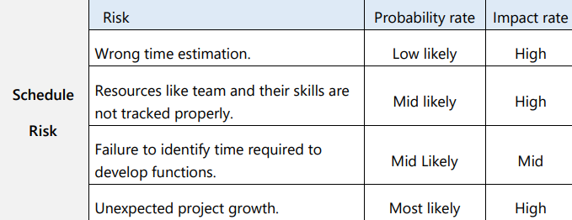
2.5 Risk Management:
• Can be avoided by:
Following up the Gantt chart regularly and reduce the critical paths in the project network. o Look after the major tasks -specially- that the other tasks depend on. o Monitor\review the agreed-on time plan. o Scheduling the risky tasks first
• Can be reduced (if happened) by: o Updating the plan to adapt with any new added requirements without affecting the already existed plan. o Maximize the rest of resources like team and tools. o Not wasting time because the problem but move forward

Slide 40
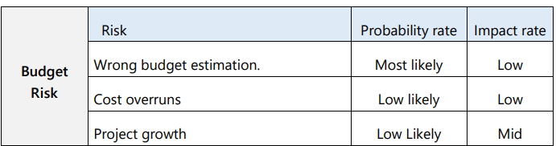
• Can be avoided by: o Good research. o Regularly checking the budget spent and needed. o Never skipping the budget through any new added requirements.
• Can be reduced (if happened) by : o Sacrifice not-so-needed resource that consume money. o Quick adaptation. o Replace cost-consuming parties with other available-resourceconsuming parties.

Slide 41
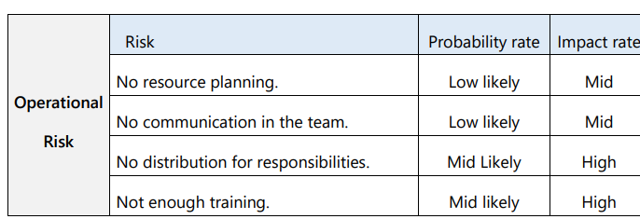
• Can be avoided by: Monitoring and evaluations at regular intervals. o Cutting the project into very small tasks. Full training before proceeding the work.
• Can be reduced (if happened) by: Adding pieces of training into the normal work. o Rotation through the training. o Changing the responsibilities to achieve the best optimized output. o Learning and planning again

Slide 42
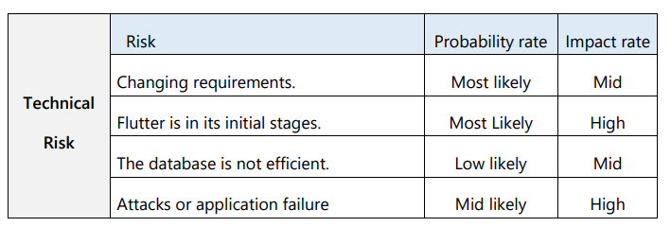
• Can be avoided by: o Preparing the threats and actions resulted. o Understanding the platform\tools used. o Not rushing the analysis phase. o Specifying the desired outcome. o Detailed test cases and regulations.
• Can be reduced (if happened) by: o Analyzing the security threats. o Preparation for facing any attack. o Quick adaptation to any new requirements. o Evaluating \monitoring the database from time to time

Slide 43
3.Software Design
In this chapter, we will go deeper in Health Plus+’s design,and present its diagrams

Slide 44
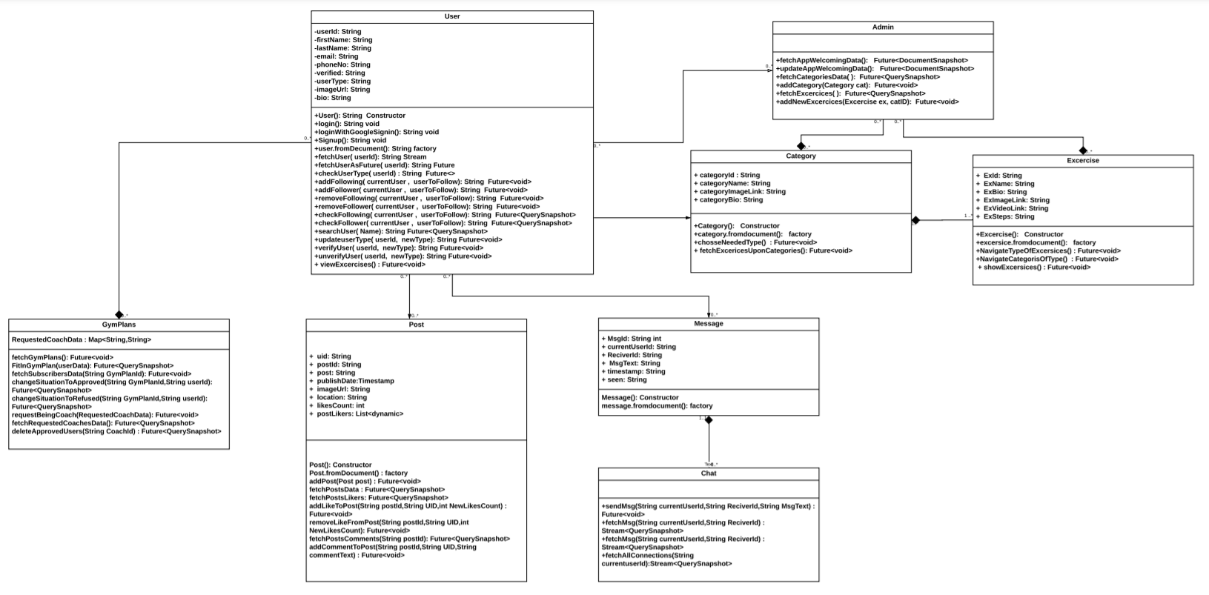
3.1 Class Diagram

Slide 45
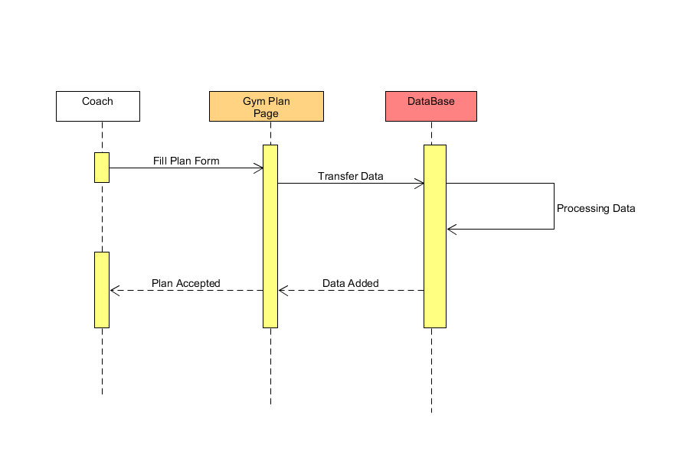
3.2.1 Sequence Diagram – Add Gym Plan:

Slide 46
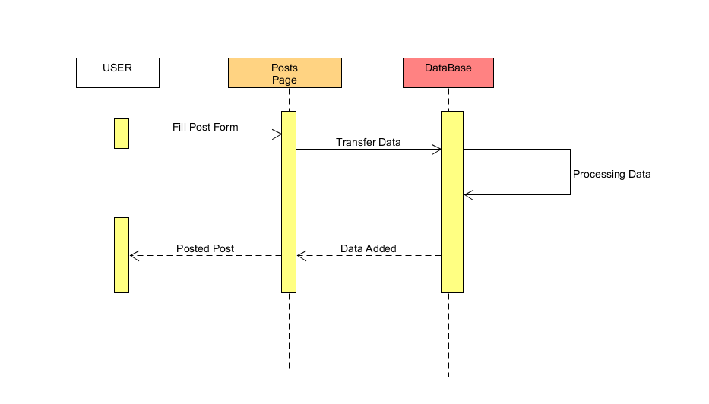
3.2.2 Sequence Diagram – Add Post :

Slide 47
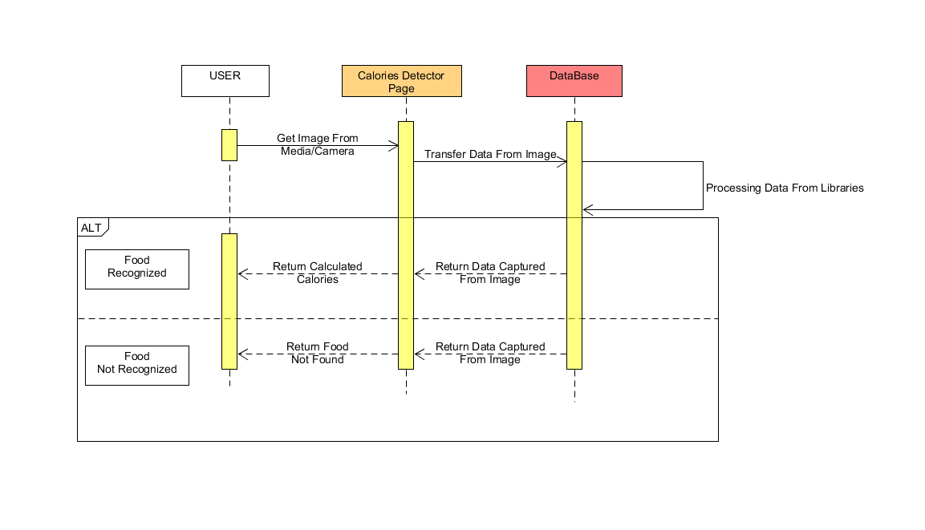
3.2.3 Sequence Diagram – Detect Calories:

Slide 48
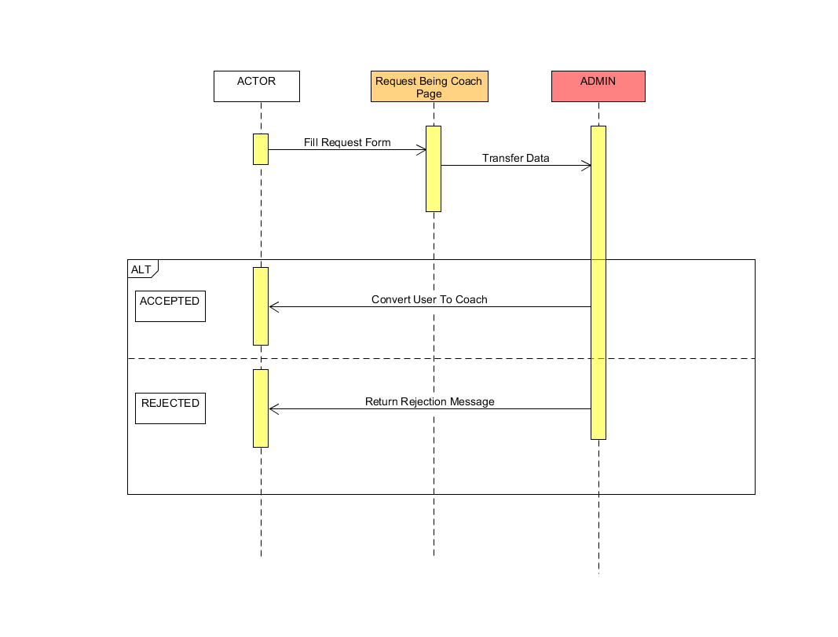
3.2.4Sequence Diagram – Request Being Coach :

Slide 49
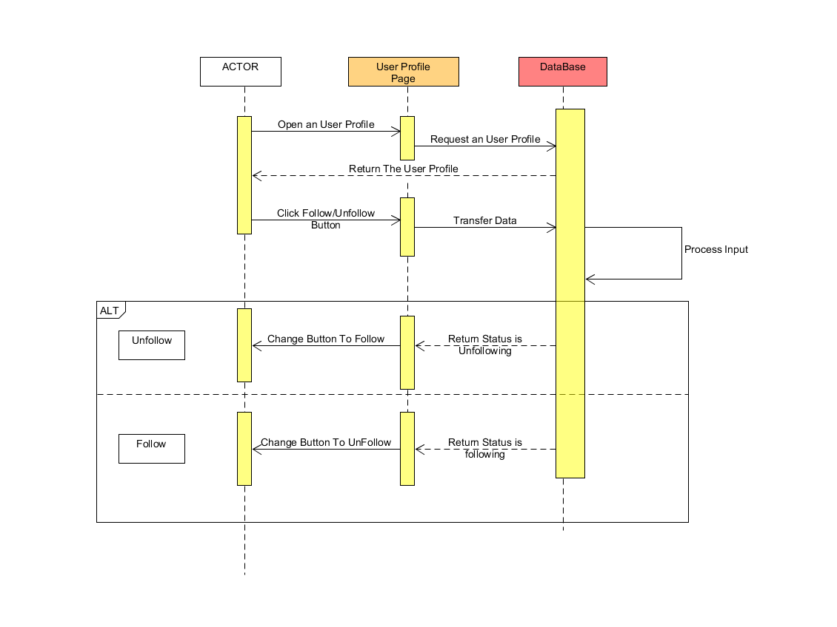
3.2.5 Sequence Diagram – Follow/Unfollow:

Slide 50
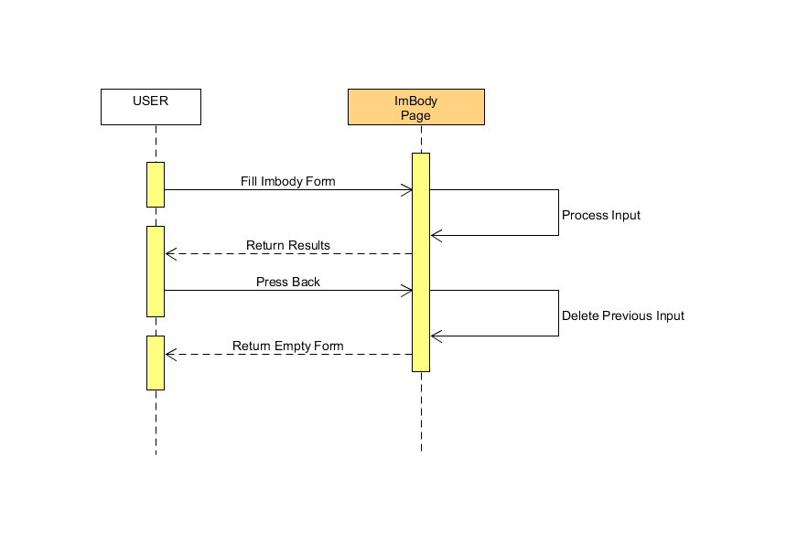
3.2.6 Sequence Diagram – Inbody Info :

Slide 51
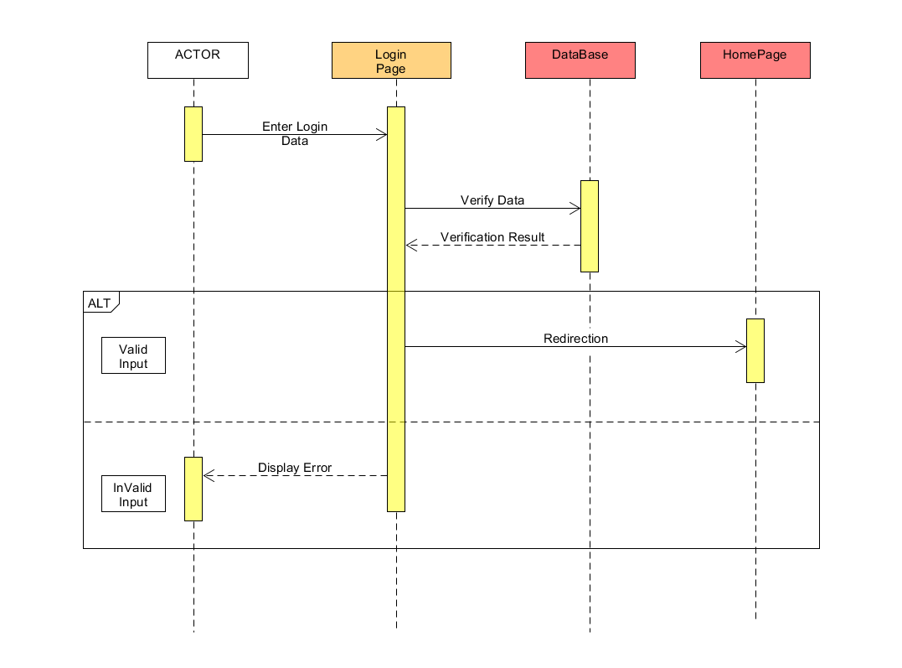
3.2.7 Sequence Diagram – Login:

Slide 52
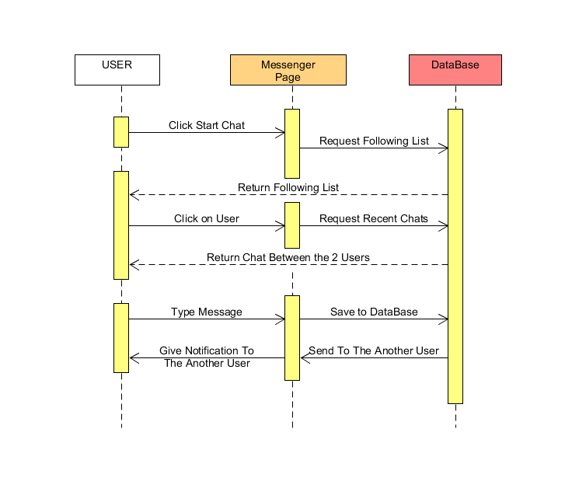
3.2.8 Sequence Diagram – Messenger :

Slide 53
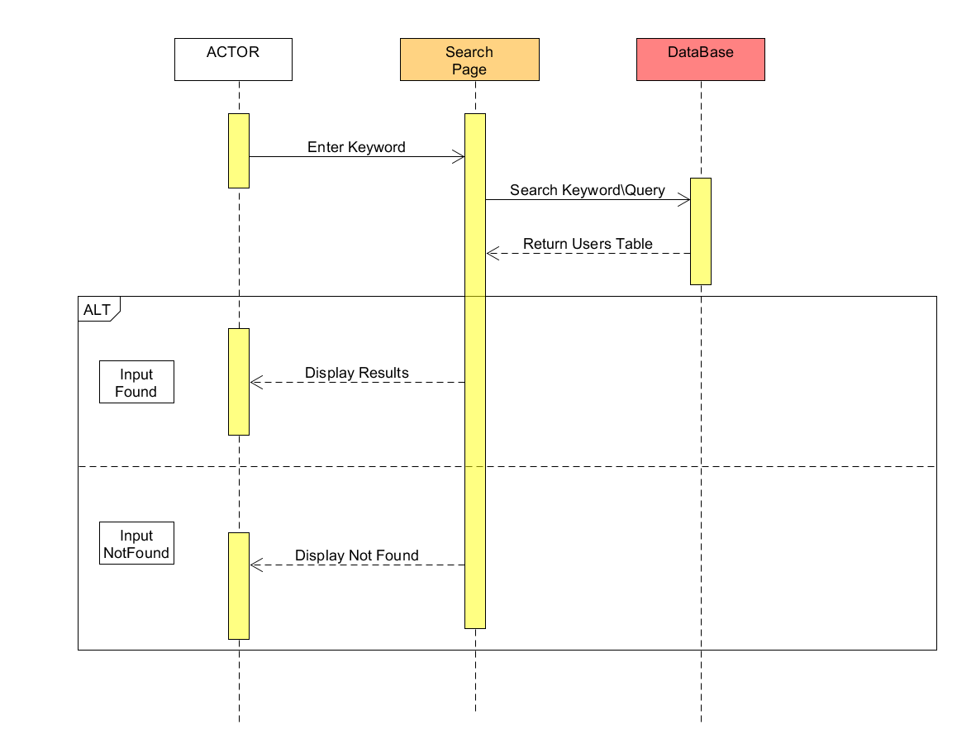
3.2.9 Sequence Diagram – Search:

Slide 54
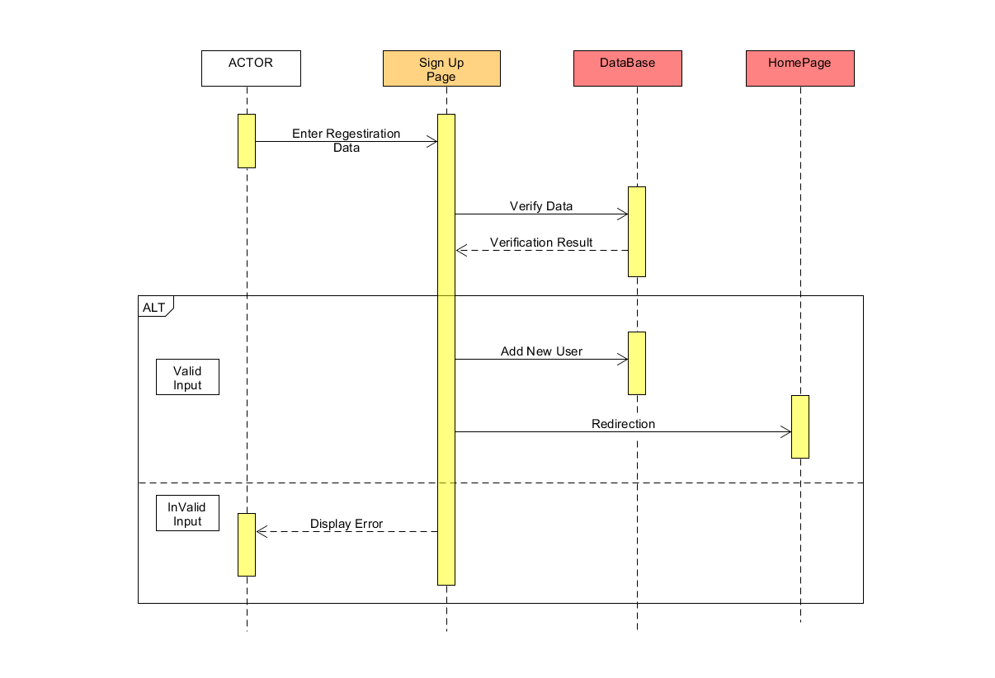
3.2.10 Sequence Diagram – Sign Up:

Slide 55
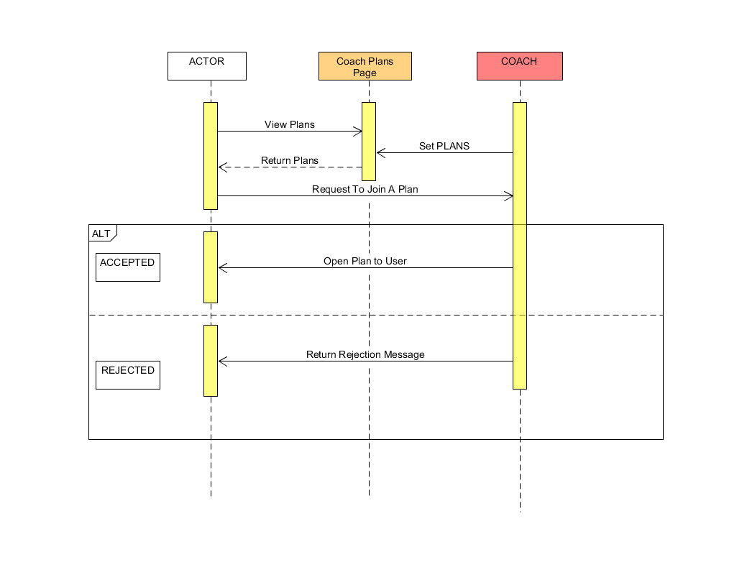
3.2.11 Sequence Diagram – Subscribe Gym Plan :

Slide 56
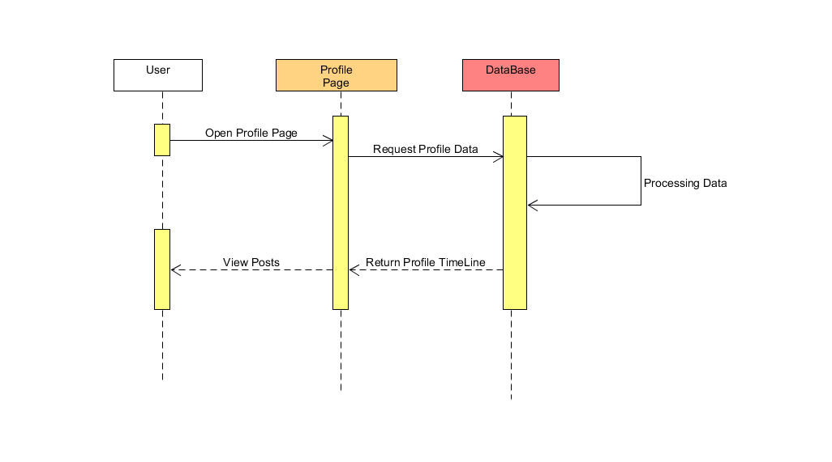
3.2.12 Sequence Diagram – View Timeline:

Slide 57
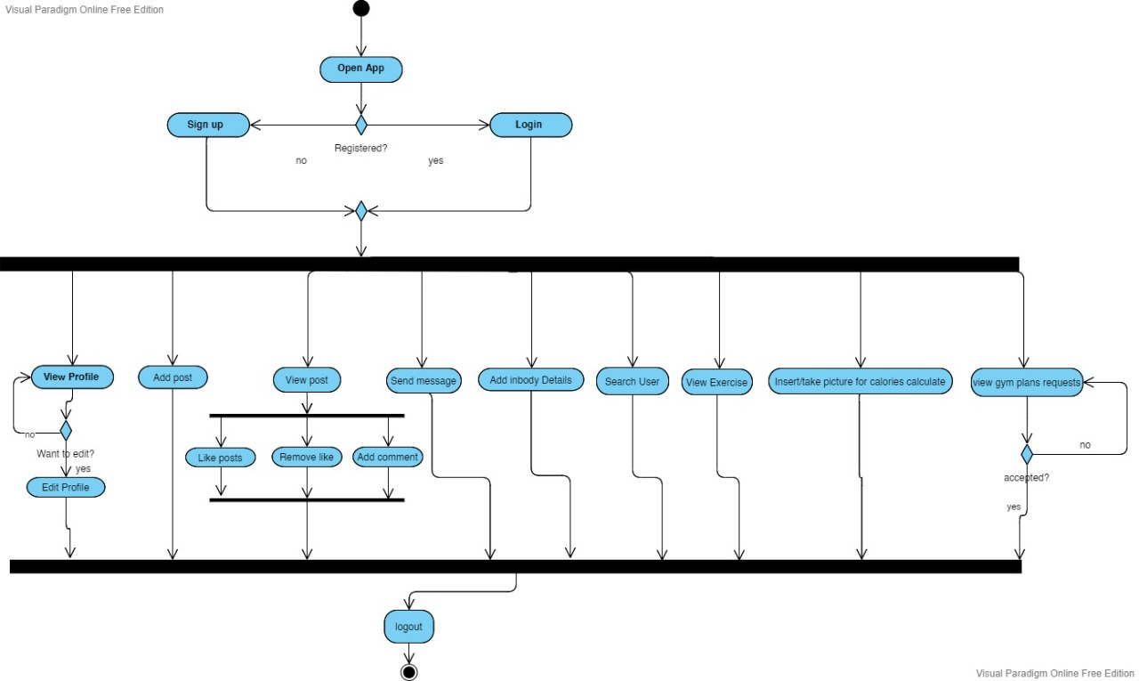
3.3.1 Activity diagram – Coach:

Slide 58
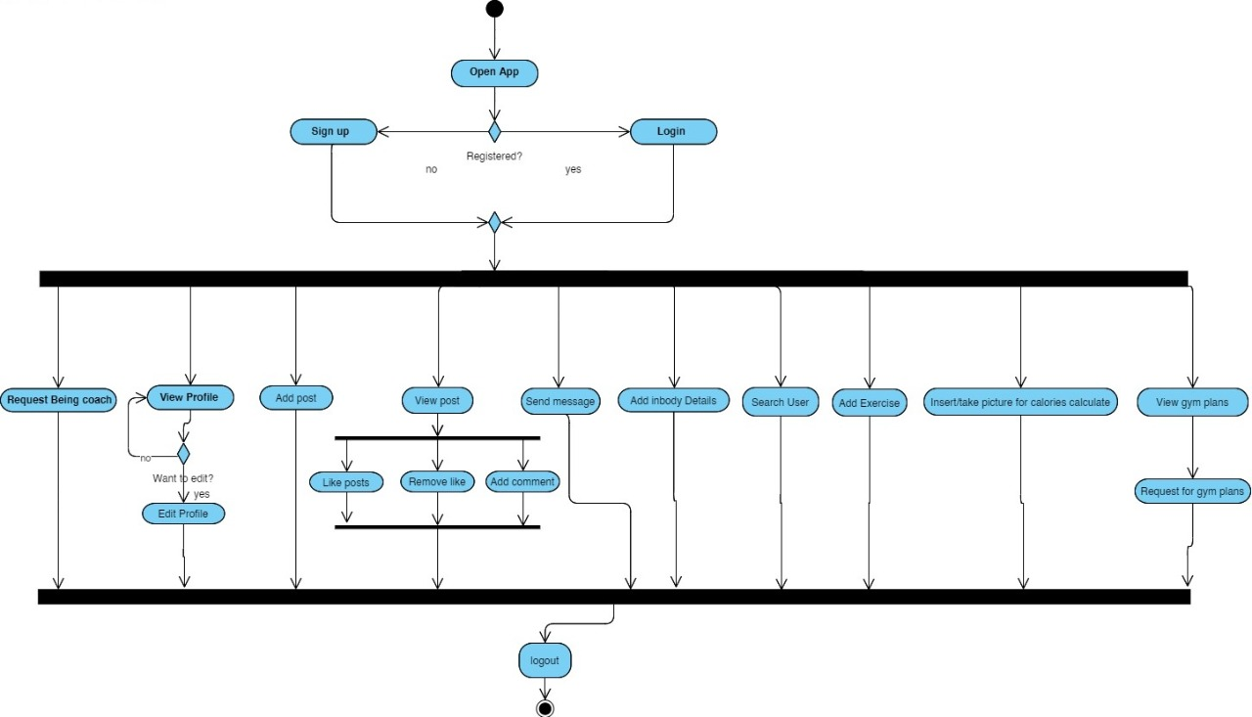
3.3.2 Activity Diagram – User:

Slide 59
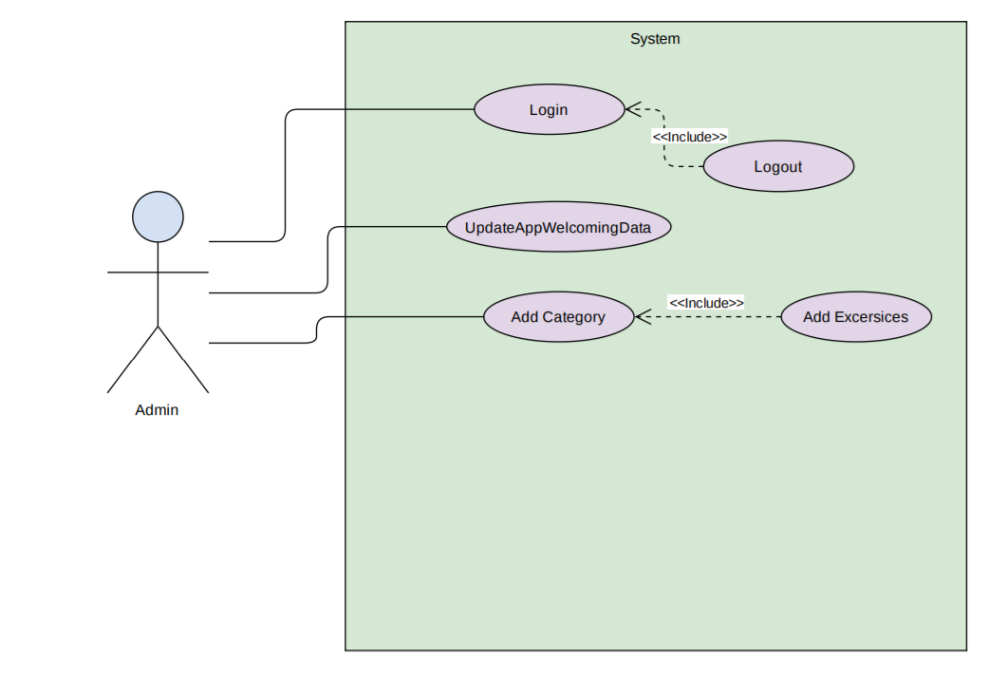
3.4.1 Use case Diagram – Admin :

Slide 60
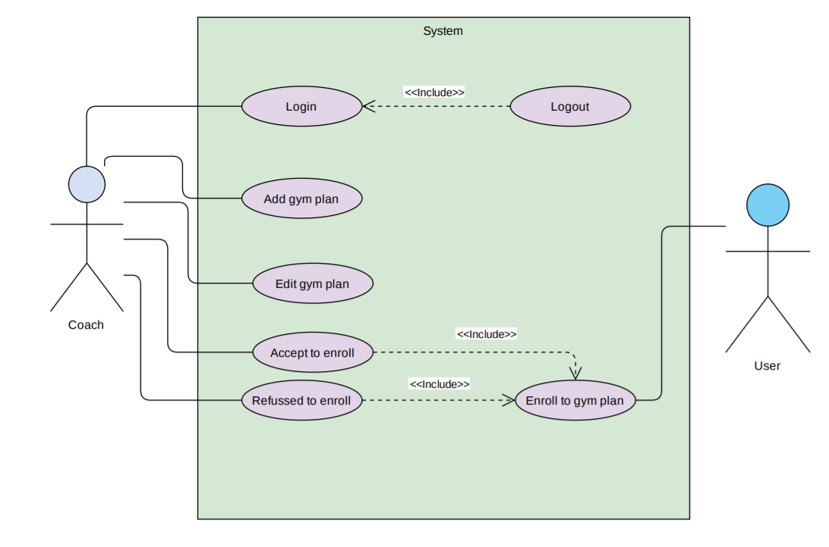
3.4.2 Use case Diagram – Coach :

Slide 61
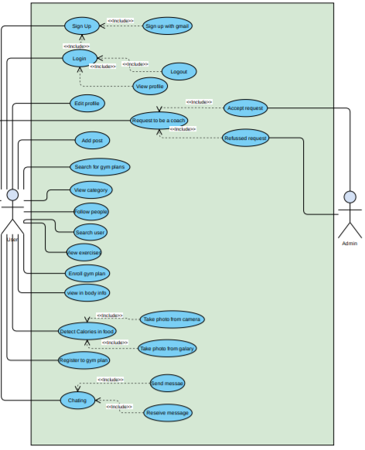
3.4.3 Use case Diagram – User:

Slide 62
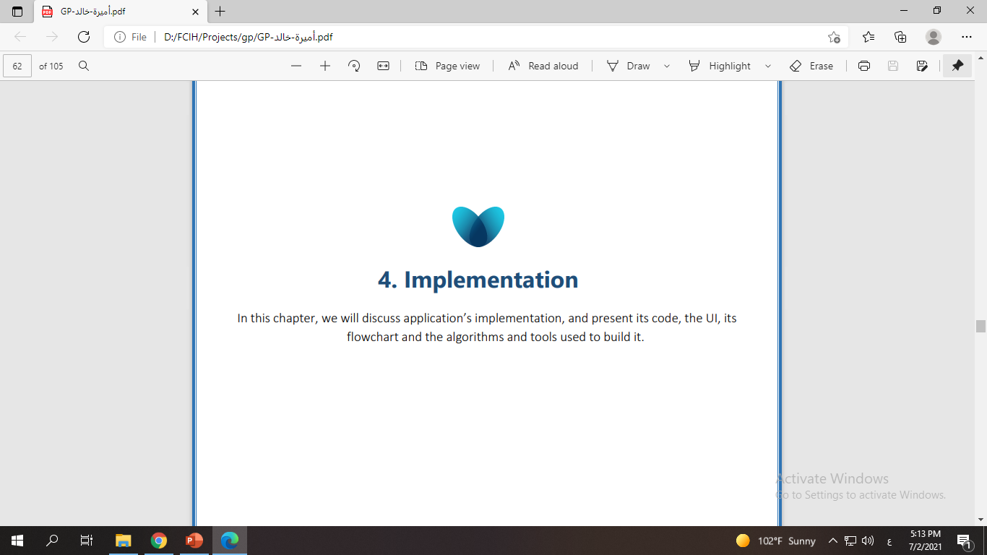

Slide 63
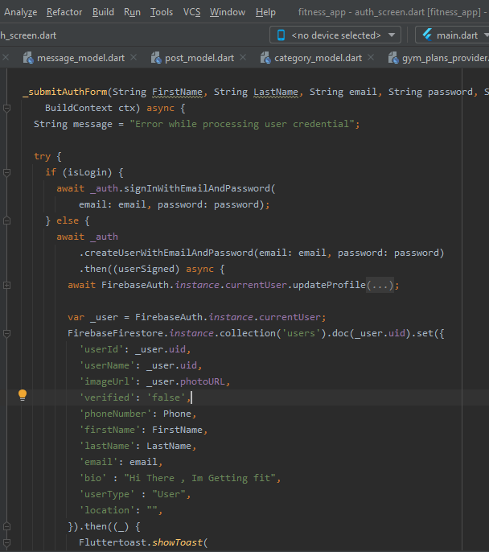
Algorithms:
4.1.1 Search - Search by name, while we located all the user data stored in the
Fire base cloud , we can retrieve and fetch all the data using the core functions of firebase then we store in alist , so we can search by names in this list of users.
4.2 Software architecture - Sign Up & Sign In

Slide 64
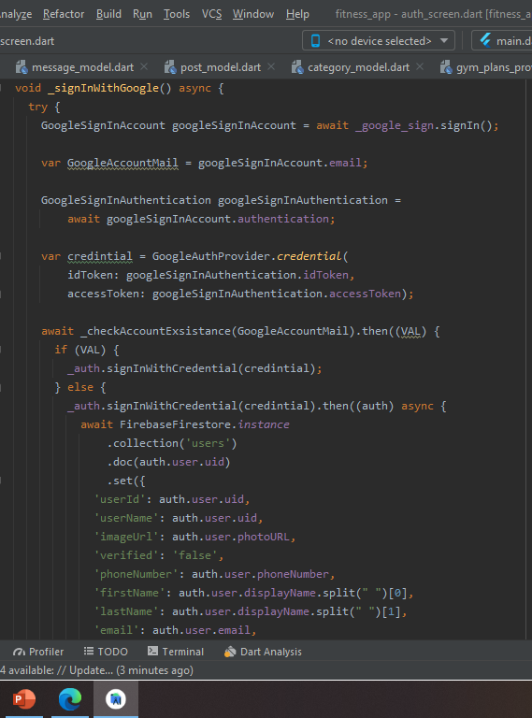

Slide 65
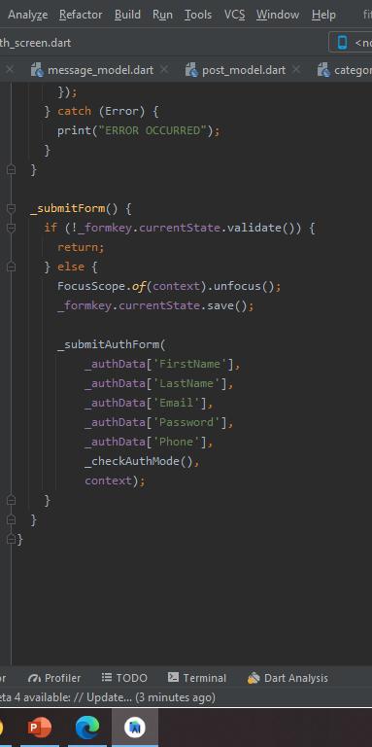

Slide 66
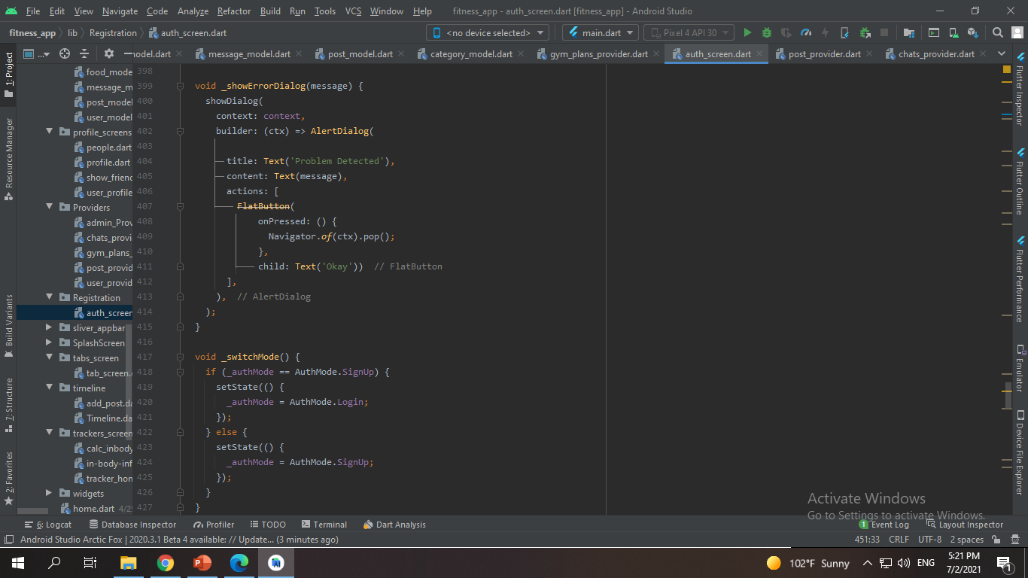

Slide 67
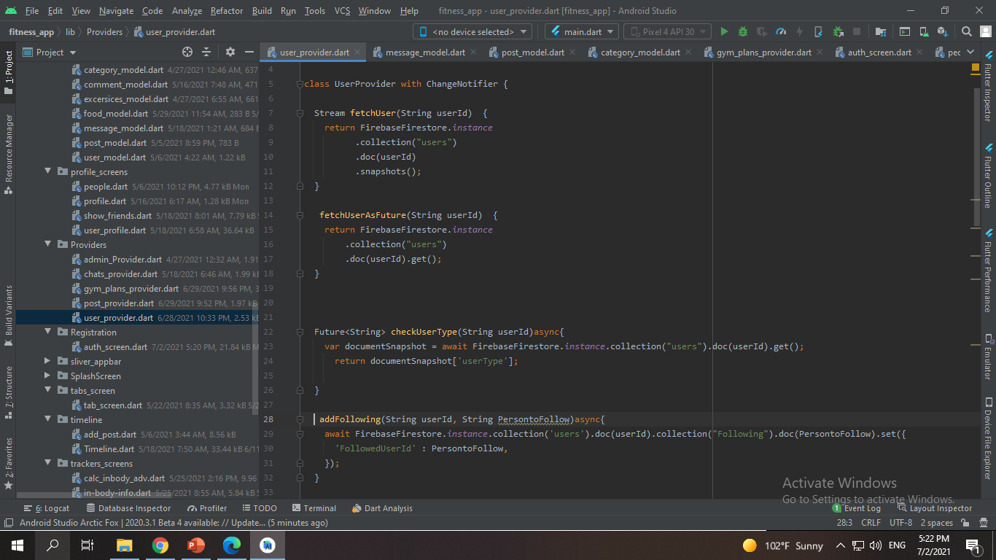
User Controller

Slide 68
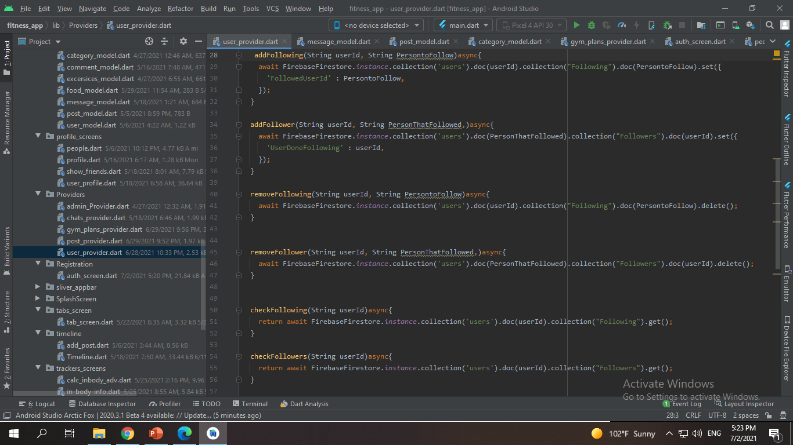

Slide 69
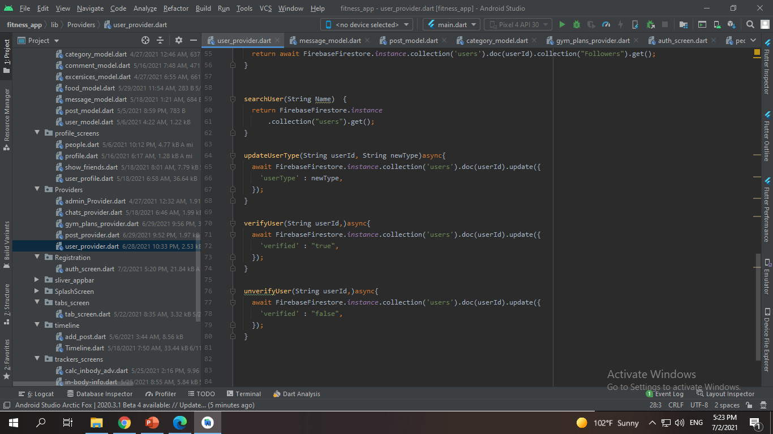

Slide 70
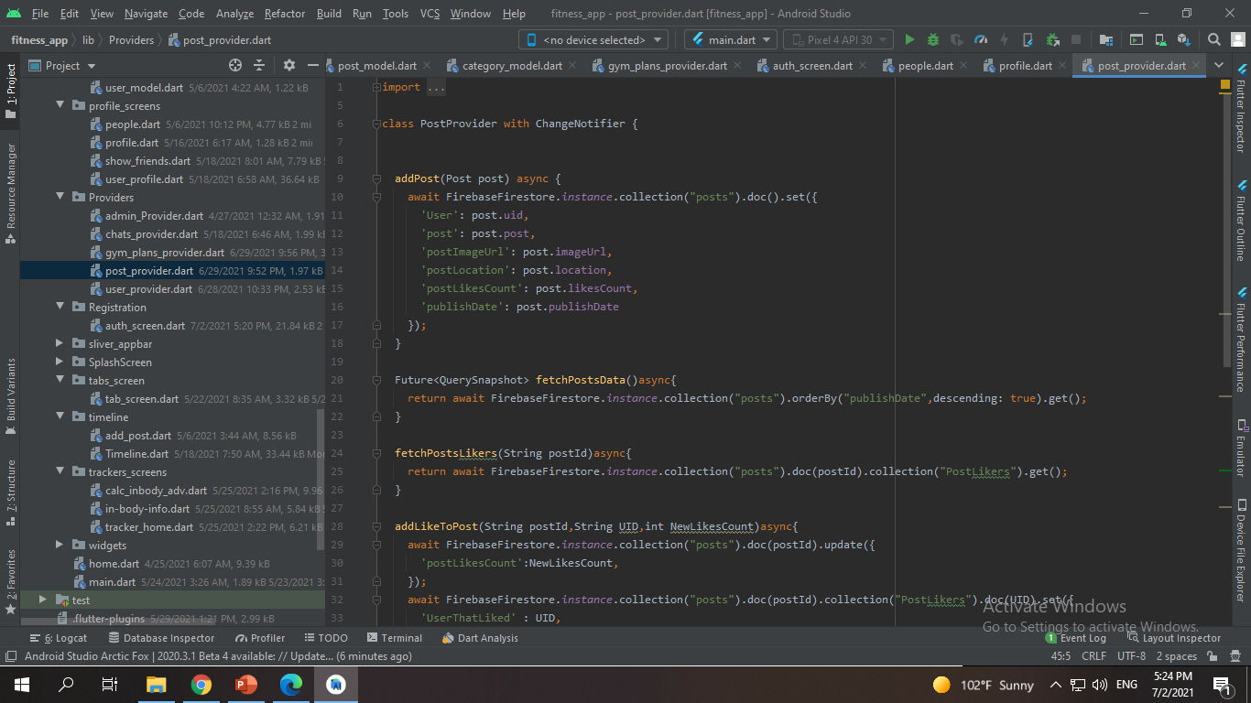
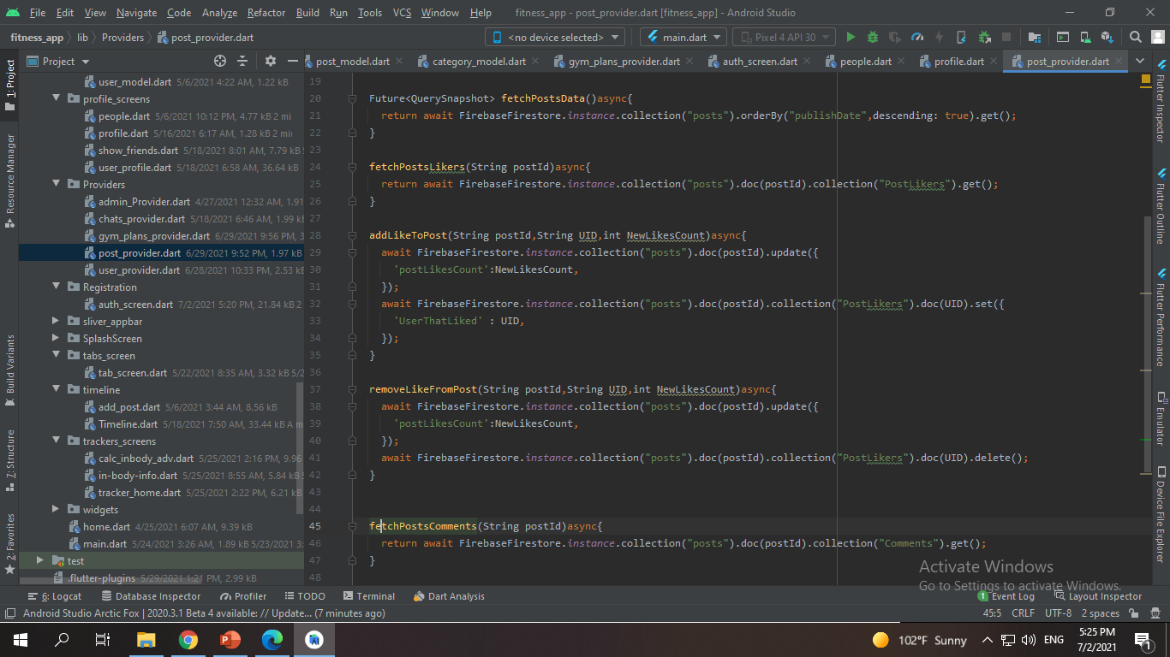

Slide 71
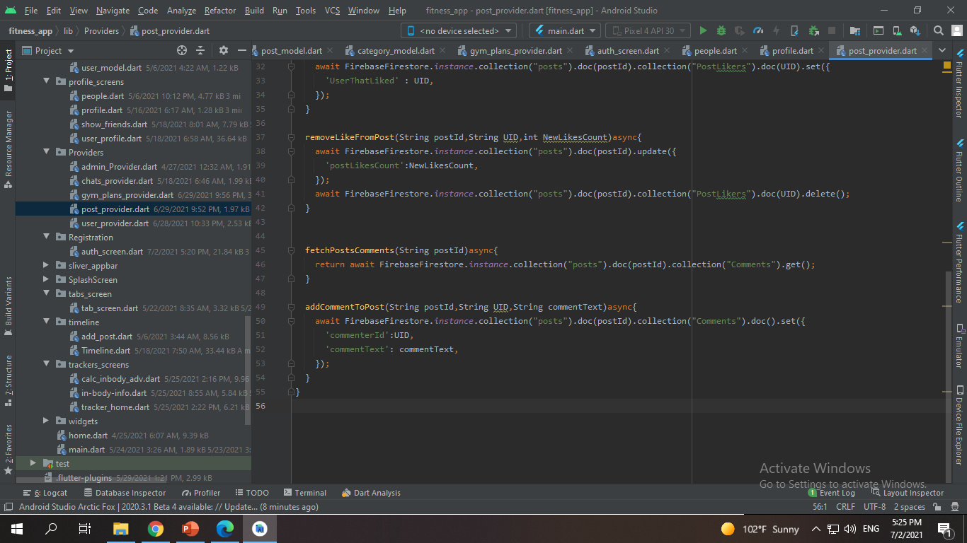
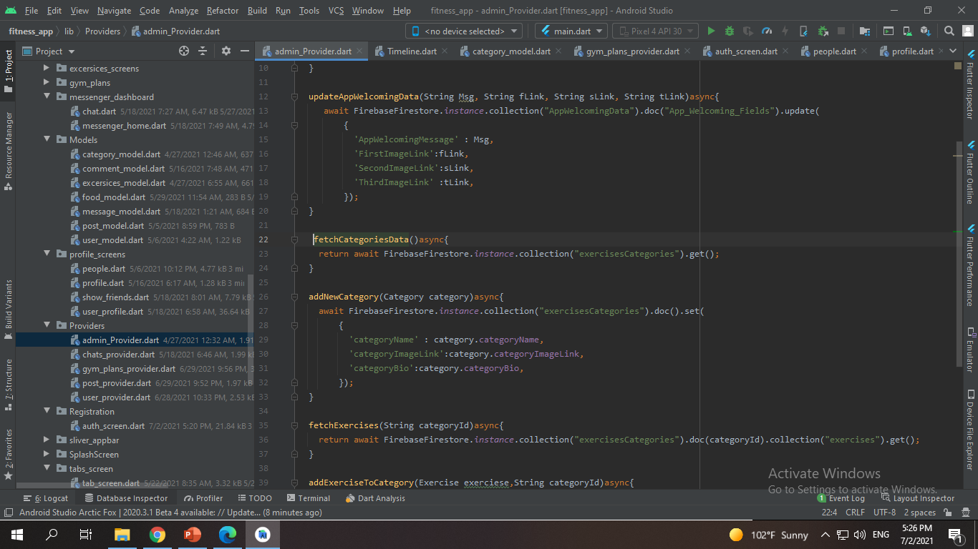

Slide 72
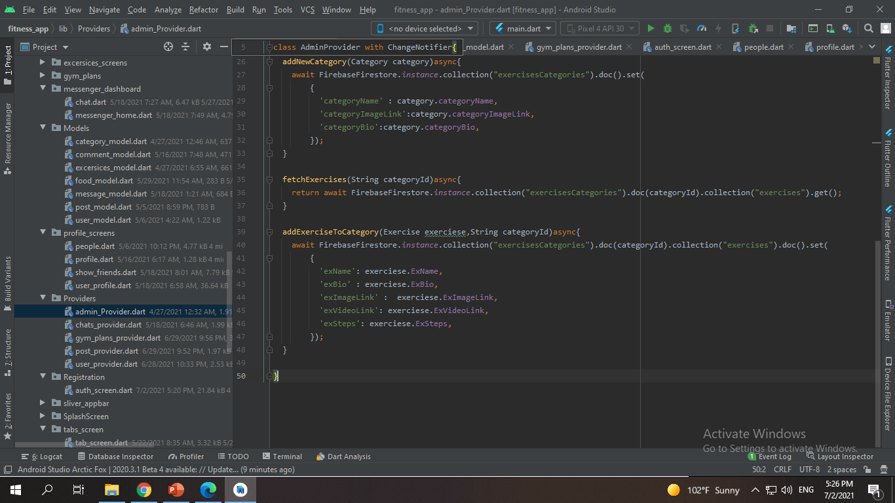

Slide 73
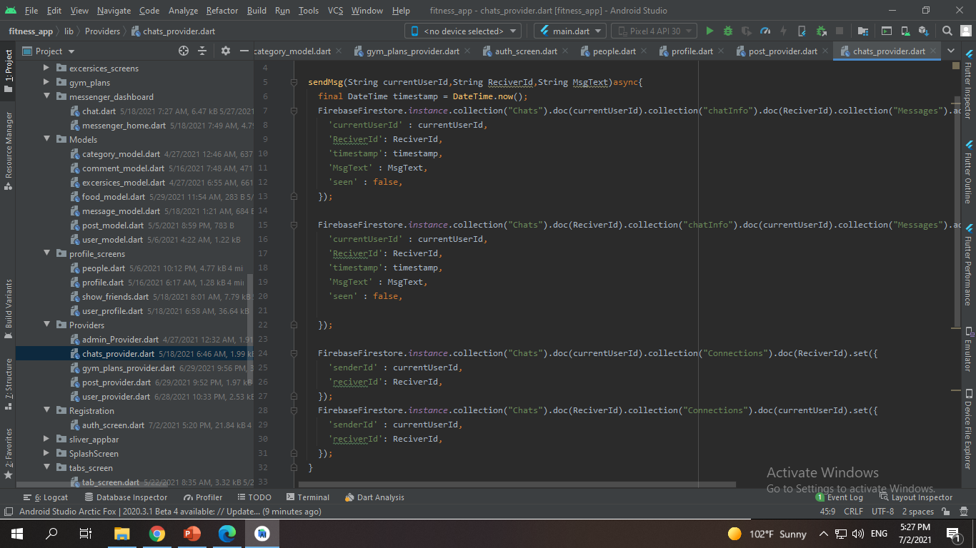

Slide 74
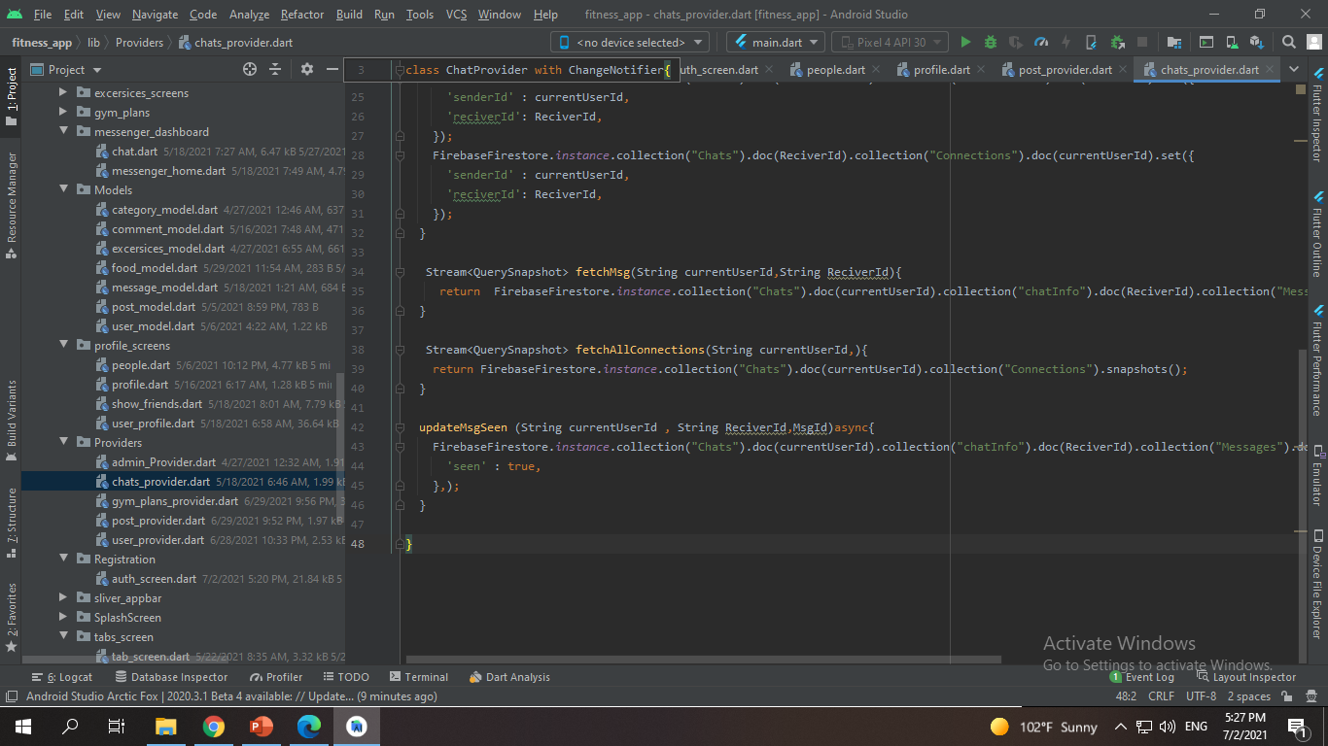

Slide 75
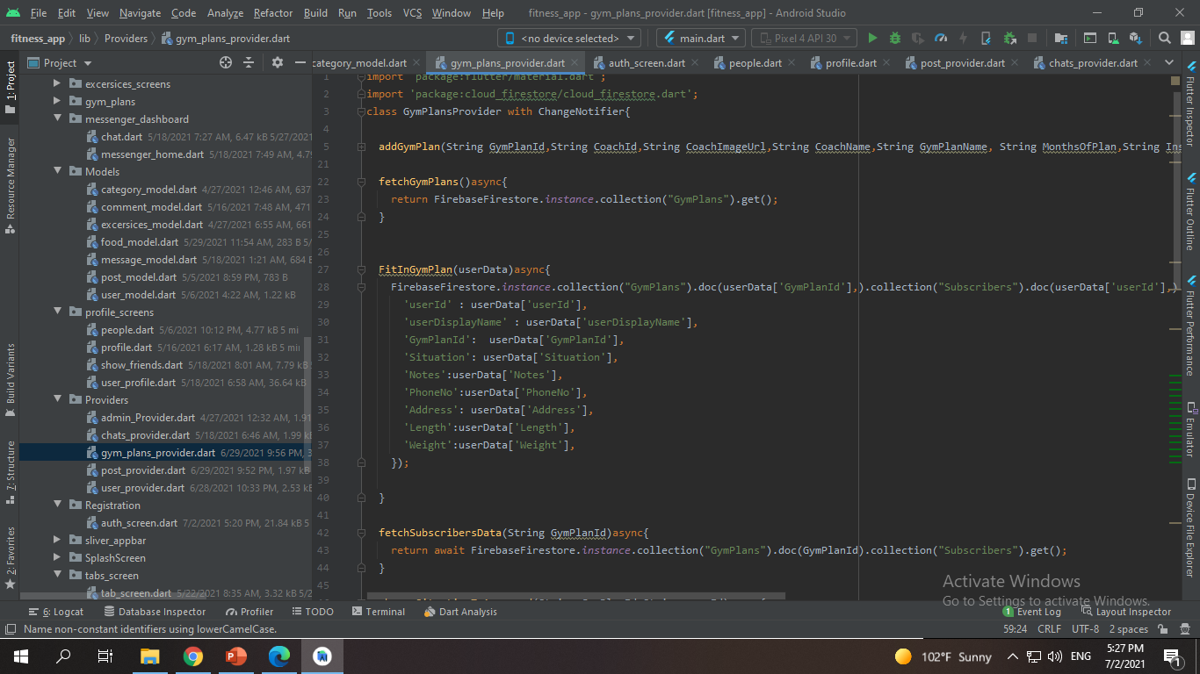

Slide 76
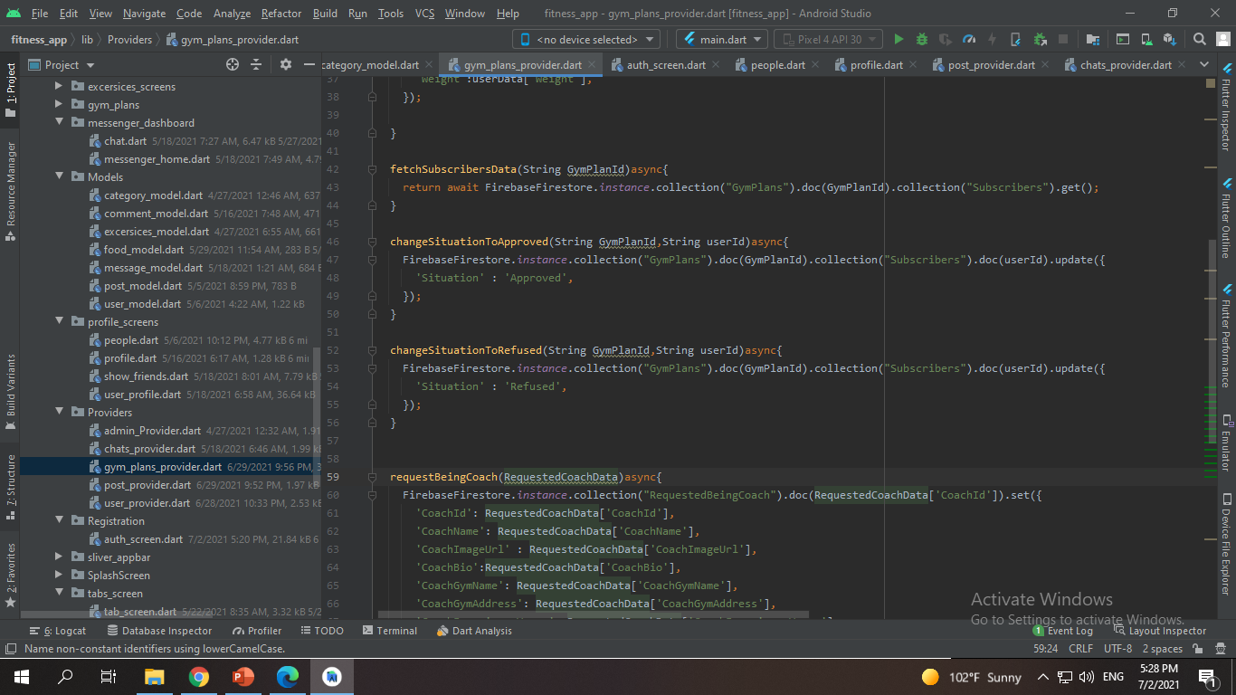

Slide 77
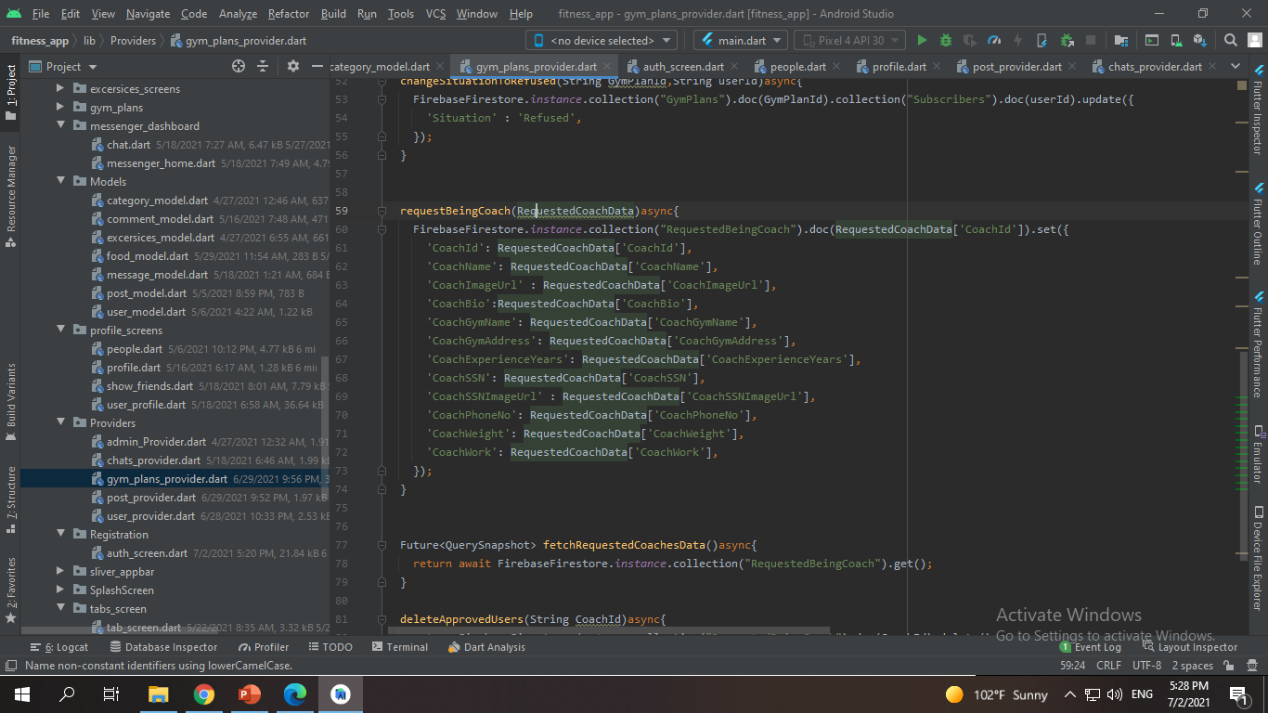
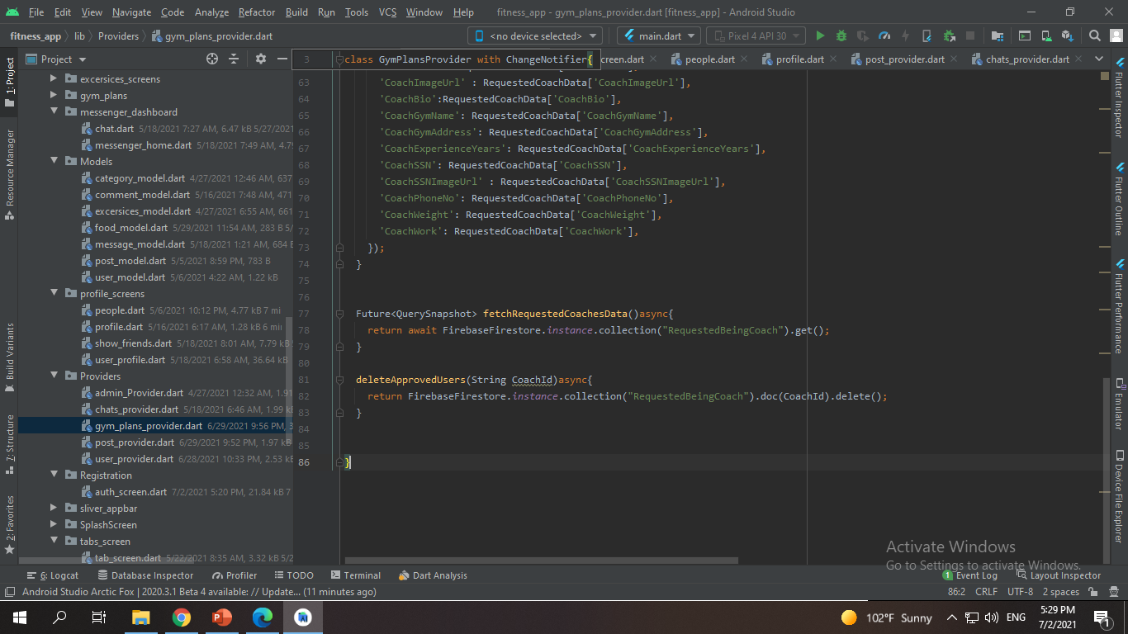

Slide 78
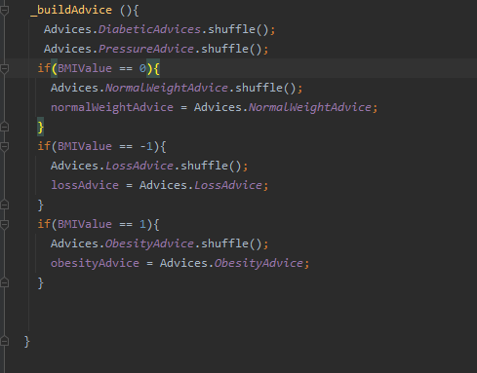

Slide 79
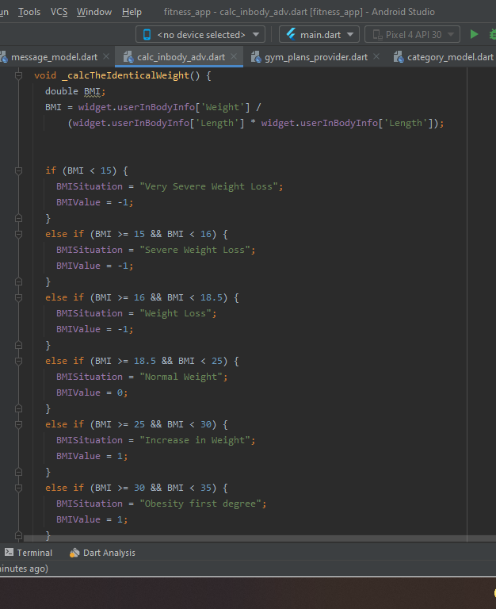

Slide 80
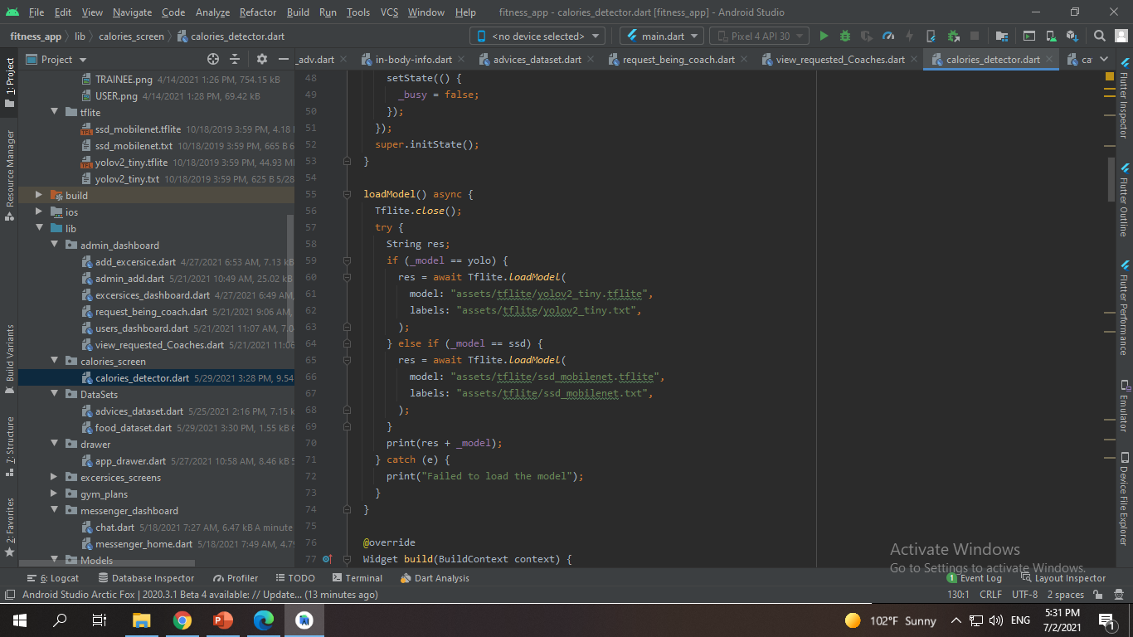

Slide 81
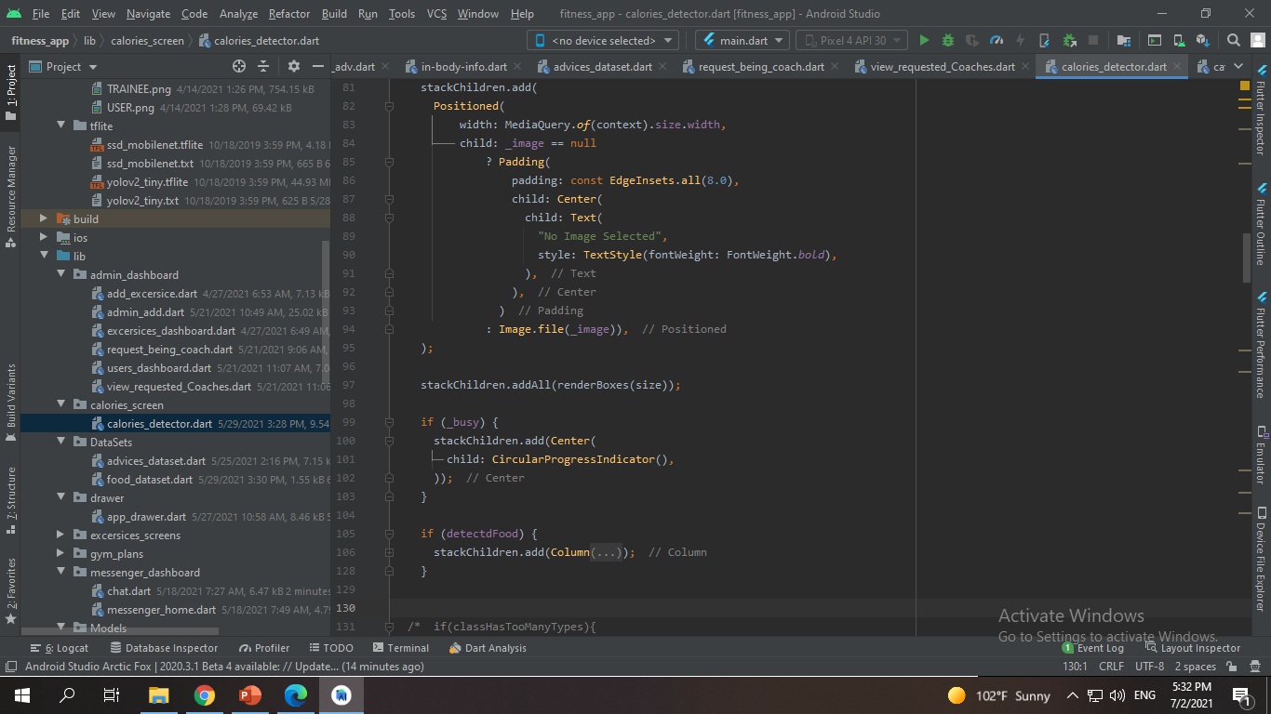

Slide 82
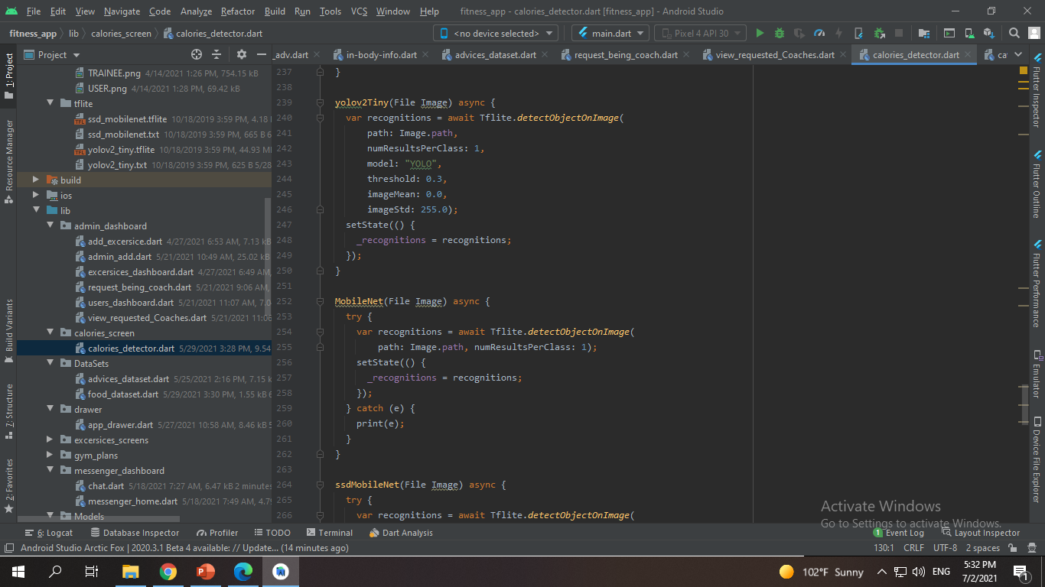

Slide 83


Slide 84


4.3 Screens :

Slide 85


Slide 86



Slide 87



Slide 88



Slide 89



Slide 90



Slide 91

4.4.1 Flow chart – Coach :

Slide 92

4.4.2 Flow chart – User:

Slide 93
4.5 Software tools
4.5.1 Flutter
Flutter is an open-source UI Software Development Kit created by Google. It is used to develop applications for Android, iOS ,Linux, Mac, Windows, We chose it for advantages and capabilities to develop cross-platform apps for iOS and Android using a single codebase.
4.5.2 Firebase
Firebase is a toolset includes things like analytics, authentication, databases, configuration, file storage, push messaging, and the list goes on. The services are hosted in the cloud, and scale with little to no effort on the part of the developer.
4.5.3 Android Studio Android Studio is the official Integrated Development Environment (IDE) for Android app development, based on IntelliJ IDEA . On top of IntelliJ's powerful code editor and developer tools, Android Studio offers even more features that enhance your productivity when building Android apps, such as:
A flexible Gradle-based build system
A fast and feature-rich emulator
A unified environment where you can develop for all Android devices
Apply Changes to push code and resource changes to your running app without restarting your app
Code templates and GitHub integration to help you build common app features and import sample code
Extensive testing tools and frameworks
.

Slide 94


Slide 95
5.1 functional testing
5.1.1 Unit Testing ✔
Testing of individual items (e.g. modules, programs, objects, classes, etc.) As part of the coding phase, in isolation from other development items and the system as a whole.
5.1.2 Integration testing ✔
Testing the interfaces between major (e.g. systems level application modules) and minor (e.g. individual programs or components) items within the application, also, testing the application as whole after committing a file into a branch on GitHub.
5.1.3 System testing ✔
Testing a system behavior after it is fully integrated, as a whole when development is finished, hence, the system can be tested as complete entity.
5.1.4 Regression Testing ✔
To check older functionality after integrating new functionality.
5.1.5 Acceptance testing ✔
Testing to evaluate the application compliance to ensure that a it is ready to be deployed into the business, operational or production environment.

Slide 96
5.2 Non-Functional Testing
5.2.1 Performance Testing
Accomplished a designated function regarding processing time and through put rate.
5.2.2 Load Testing
Measuring the behavior of within creasing load that can be handled by the component or system.
5.2.3 Stress Testing
Evaluate a system or component at or beyond the limits of its specified requirements.
5.2.4 Security Testing
Testing how well the system protects against unauthorized internal or external access

Slide 97
5.3 Test Cases :
Test Case ID | Test Scenario | Test steps | Test data | Expected results | Actual results | Pass or Fail
01 | Check user register with valid data | 1. Open application 2. Chooses Sign up 3. Enter First name 4. Enter Last Name 5. Enter email 6. Enter password 7. confirm password 8. Enter Phone Number 9. Tap on “Submit” | Full name= Amir Nasser Email= amirnasser989@gmail.com Password: 1234567 Confirm Password: 1234567 Phone number: 01016330876 | User will be proceeded to the next step. | As expected | Pass
02 | Check user register with invalid Email | 1. Open application 2. Chooses Sign up 3. Enter First name 4. Enter Last Name 5. Enter email 6. Enter password 7. confirm password 8. Enter Phone Number 9. Tap on “Submit” | Full name= Amir Nasser Email= amirnasser989@gmailcom Password: 1234567 Confirm Password: 1234567 Phone number: 01016330876 | User cannot be proceeded to the next step. | Error while processing user credential / Invalid Email | Fail
03 | Check user register with invalid Confirm password | 1. Open application 2. Chooses Sign up 3. Enter First name 4. Enter Last Name 5. Enter email 6. Enter password 7. confirm password 8. Enter Phone Number 9. Tap on “Submit” | Full name= Amir Nasser Email= amirnasser989@gmail.com Password: 1234567 Confirm Password: 123456 Phone number: 01016330876 | User cannot be proceeded to the next step. | Password doesn’t match | Fail

Slide 98
04 | Check user register with invalid password doesn’t match confirm password | 1. Open application 2. Chooses Sign up 3. Enter First name 4. Enter Last Name 5. Enter email 6. Enter password 7. confirm password 8. Enter Phone Number 9. Tap on “Submit” | Full name= Amir Nasser Email= amirnasser989@gmail.com Password: 123456 Confirm Password: 1234567 Phone number: 01016330876 | User cannot be proceeded to the next step. | Password doesn’t match | Fail
05 | Check user register with invalid Phone number | 1. Open application 2. Chooses Sign up 3. Enter First name 4. Enter Last Name 5. Enter email 6. Enter password 7. confirm password 8. Enter Phone Number 9. Tap on “Submit” | Full name= Amir Nasser Email= amirnasser989@gmail.com Password: 1234567 Confirm Password: 1234567 Phone number: 010163308 | User cannot be proceeded to the next step. | Invalid Phone | Fail

Slide 99
Test Case ID | Test Scenario | Test steps | Test data | Expected results | Actual results | Pass or Fail
06 | Check user sign in with valid data | 1. Open app 2. Tap sign in 3. Enter Email 4. Enter password 5. tap login | Email= amirnasser989@gmail.com password= 1234567 | User will be proceeded to the next step. | As Expected | Pass
07 | Check user sign in with invalid Email | 1. Open app 2. Tap sign in 3. Enter invalid Email 4. Enter password 5. tap login | Email= amirnasser989@gmail.cm password= 1234567 | User cannot be proceeded to the next step. | User cannot be found | Fail
08 | Check user sign in with invalid password | 1. Open app 2. Tap sign in 3. Enter Email 4. Enter invalid password 5. tap login | Email= amirnasser989@gmail.cm password= 123456 | User cannot be proceeded to the next step. | Wrong password | Fail

Slide 100


Slide 101
Expected Result:
1- get pictured image and get some calories from this picture.
2- view timeline and add post and follow and unfollow.
3- get best advices from inputing in body info.
4- connect with people in application
To message them.
5- add gym plan as coach and get some needed people to be subscribers.
6- accept gym plan subscriber and refuse it.
7- admin can update application welcoming data , verify users , accept coaches dashboard.

Slide 102
Actual Result:
1- the result of food calories are calculated perfectly.
2- you can view easily posts and navigate users and posts and message them.
3- user get many advices from our dataset for advices classification depends on BMI.
4- messenger are working perfect.
5- gym plans added perfectly and can be subscribed .
6- accept gym plan subscriber and refuse it.
7- admin can update application welcoming data , verify users , accept coaches dashboard.

Slide 103


Slide 104
Smartwatch
Track exercise from your phone or SmartwatchGet instant tips while you exercise and see real-time stats for your running, walking, and cycling activities. Health plus will use the sensors in your Smartwatch to record your exercise speed, walking and jogging path, and other data.
Barcode Scanner
quickly scan food barcodes to track your carb, macro, and calorie intake.
Add All Payments Channels
All payment methods will be added to facilitate payment operations for the user, such as Visa, Mastercard, PayPal, Skrill and Neteller
Sleep Analysis
Discover how long and how well you’re sleeping, then improve your nightly routine with Health plus innovative sleep tools—including a nightly Sleep Score, sleep goal setting, bedtime reminders and graphs that show your time in light, deep and REM sleep.
Check Heart Rate
This feature will use your phone's camera to check bpm. Just gently cover your fingertip on the back camera lens and stay still, then your heartbeat will be counted after a few seconds.

Slide 105


Slide 106
Overall this application is about to fill the space of the fitness players that got affected from corona virus so we integrate many functions to single one application that serve many fitness player
You can detect the calories and in body info to get the best results of picked image / gallery
And also calculate the BMI to know what is your real situation of weight in obsess.
Integrated with full social media network that gives you the ability to follow and un follow and react and comment and post in your timeline .. Also you can subscribe your needed gum plans and request bring coach to push gym plan and earn from our application
We worked on that project productively hard and we was a real hard working team and its obvious from our development code and our documentation .
We totally are thanking Dr. Mohamed Marie for his attention and support all the way to get finishing this amazing project

